Slide 1
Plum Creek Watershed Partnership
Steering Committee Meeting
March 24, 2022
Christina Lopez, PhD
Watershed Coordinator
Plum Creek Watershed Partnership

Slide 2
Agenda
10:00 Sign in and Refreshments
10:05 Welcome and Introductions
10:15 Updates
WPP & Events - Christina Lopez, Watershed Coordinator
Water Quality Management Plans & Workshops - Tim Auld, Conservation Technician
Plum Creek Wetlands Preserve - Stephen Risinger, Guadalupe-Blanco River Trust [tentative]
10:45 BVRT Water Resources Introduction and Overview
11:00 Break
11:10 Steering Committee Member Updates
11:20 Prioritizing WPP Management Measures Activity
12:00 Adjourn

Slide 3
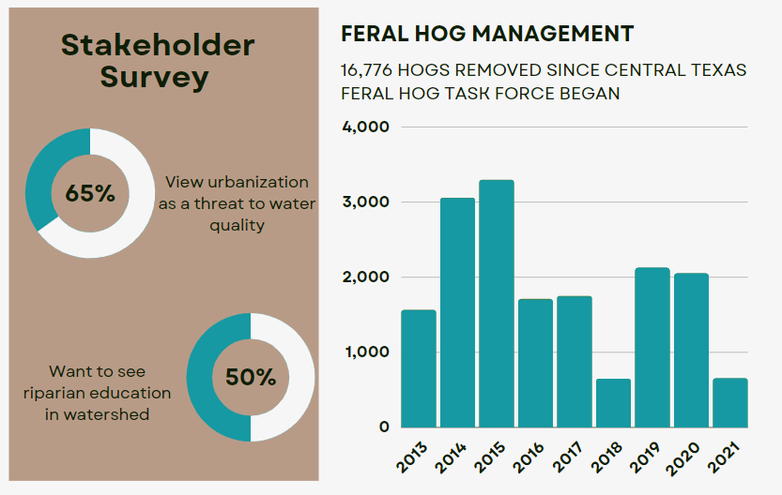
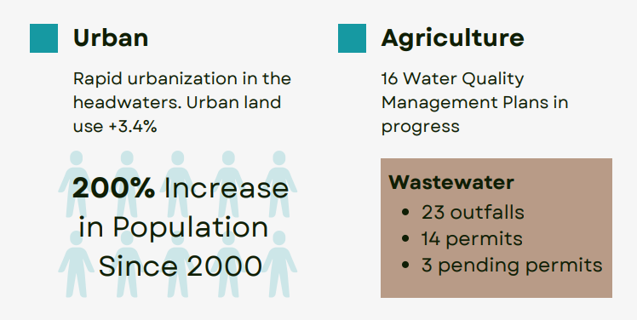
Watershed Protection Plan – 2022 Update
Under review at the Texas Commission on Environmental Quality

Slide 4
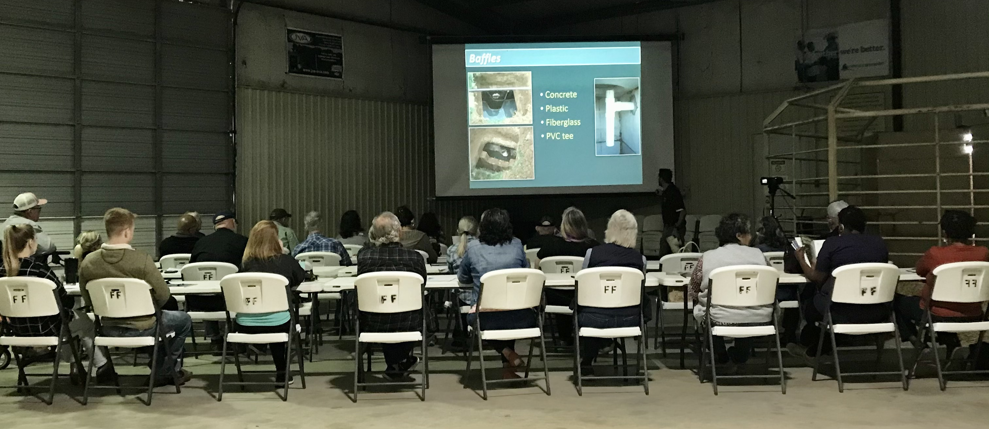
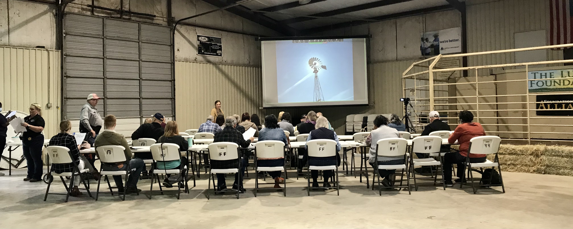
Recent Events
Texas Well Owner Network — Well Educated — The Luling Foundation
March 4, 2022
27 attendees & Facebook Livestream (100+ views)
Private water well basics, onsite wastewater treatment, & water quality testing
Presentations by PCWP and PCCD

Slide 5
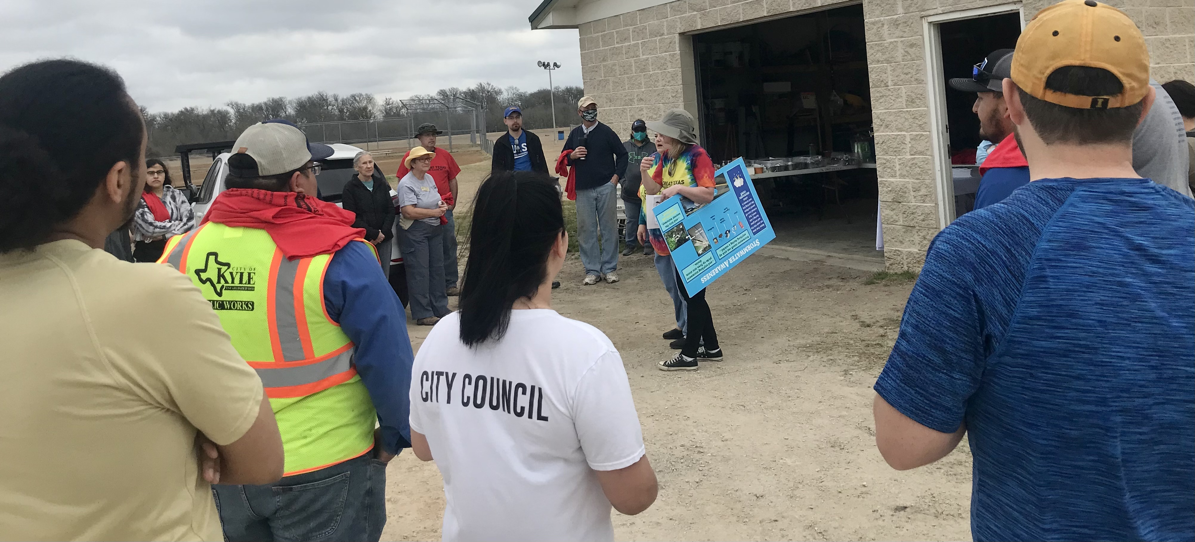
Recent Events
Great Texas River Cleanup — Upper Plum Creek — Kyle Plum Creek Trail
March 5, 2022
83 volunteers
170 lbs of recycling
2,840 lbs of trash
1 tire

Slide 7
Upcoming Events
Earth Day Celebration
Kyle Public Library, April 23, 2022
Texas Riparian & Stream Ecosystem Training
Lockhart State Park, May 12, 2022
Lone Star Healthy Streams
Seguin, June 1, 2022

Slide 8
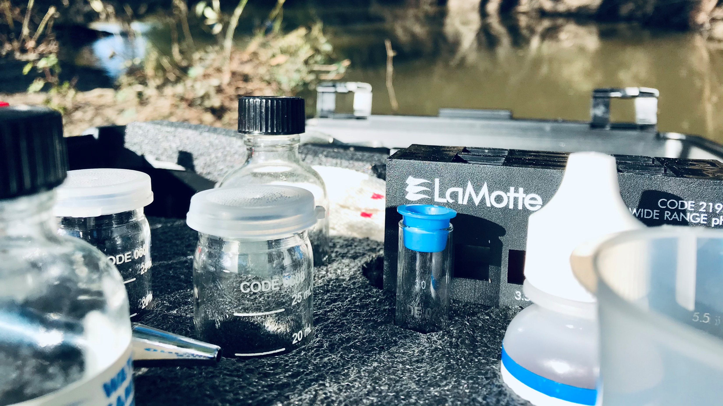
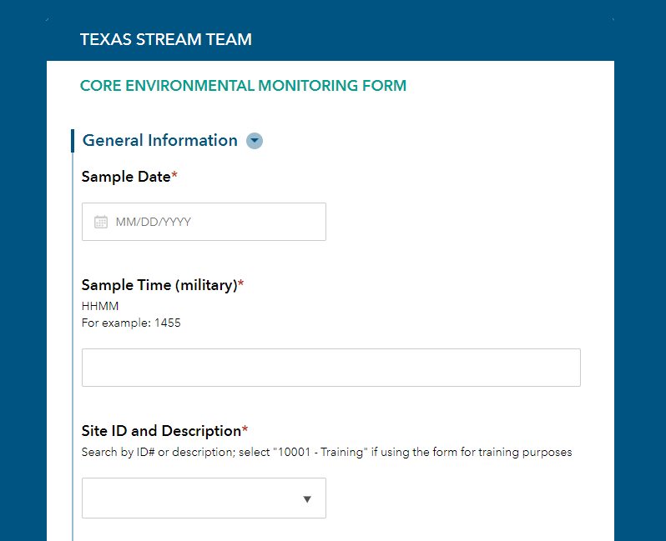
Programs
Texas Stream Team, Plum Creek Stewards
Central Texas Feral Hog Task Force
Bounty Claims – monthly through July
Caldwell County – 3rd Thursdays
Hays County – 2nd Mondays and 3rd Fridays
Workshops (TBA)
Damage Surveys (ongoing)

Slide 9
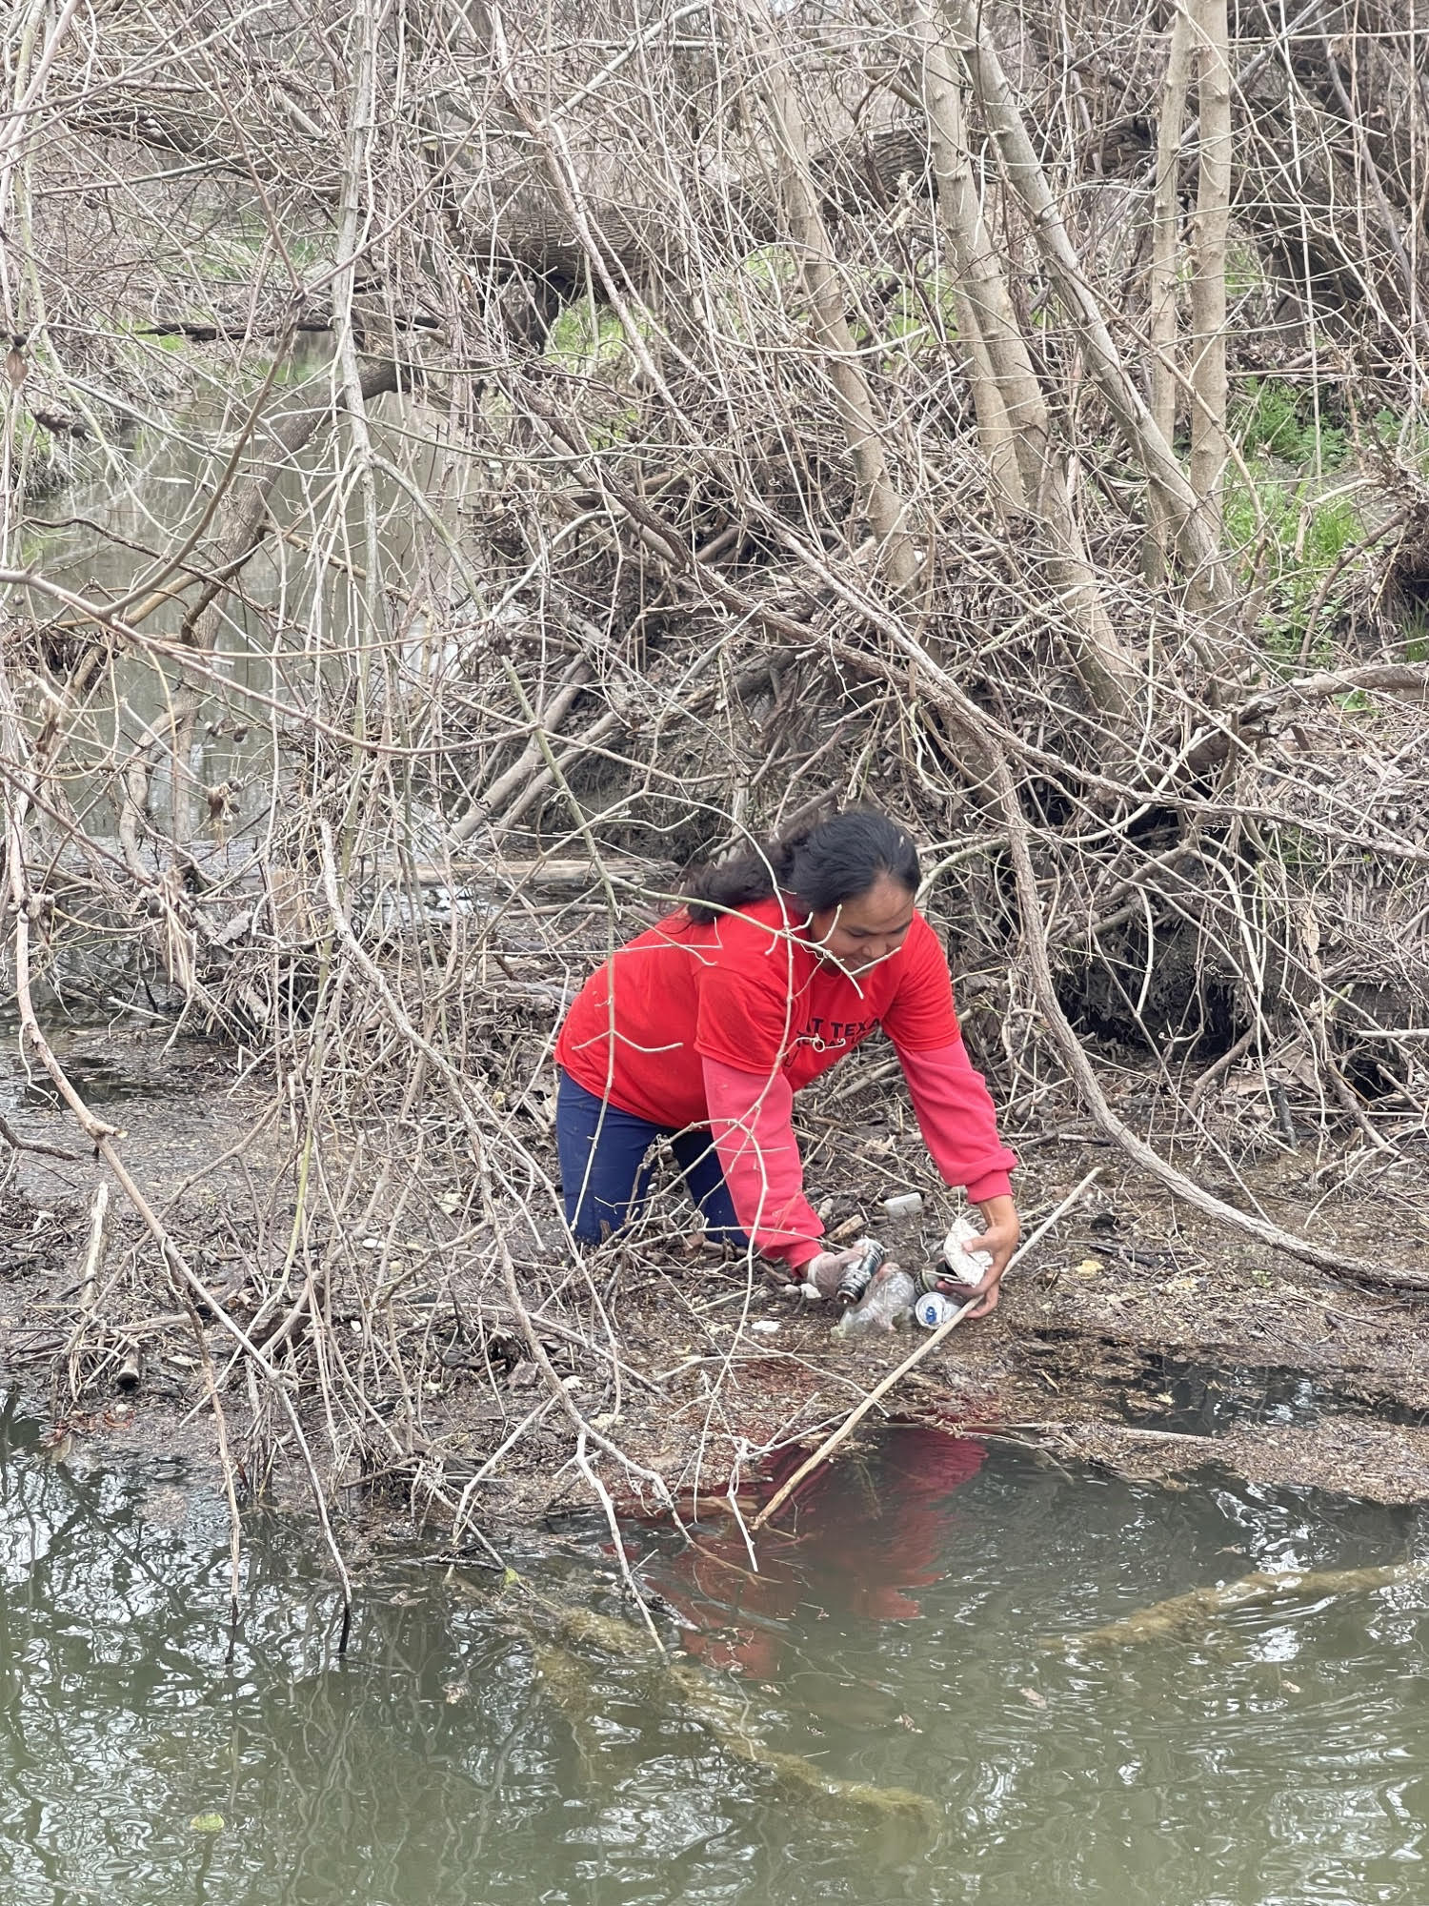
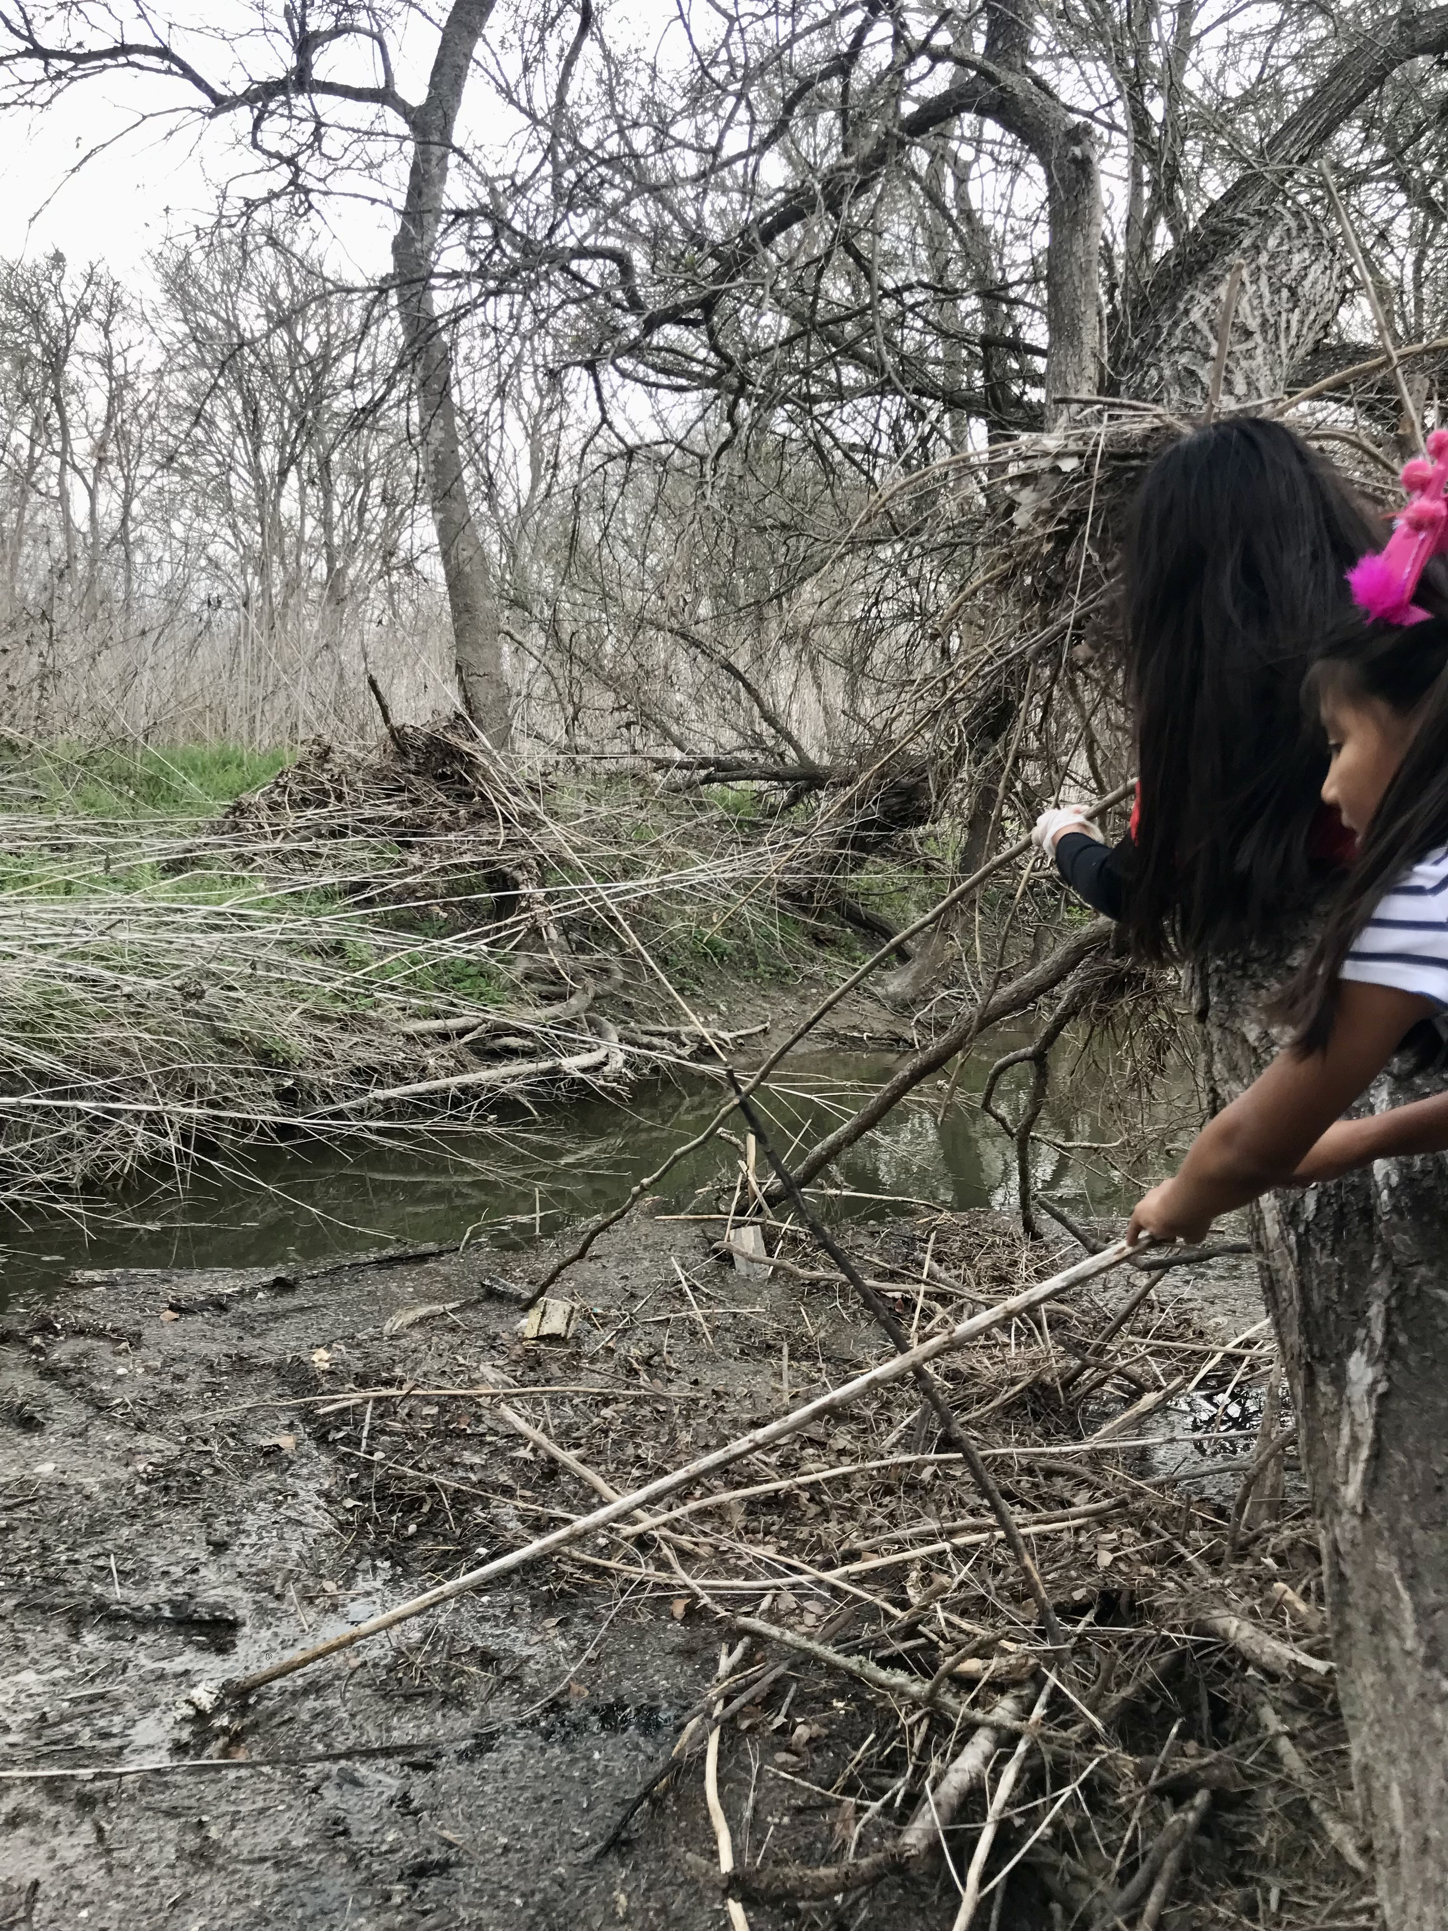

Slide 10
Water Quality Management Plan Program Updates

Slide 11
Plum Creek Wetlands Preserve Updates

Slide 12
BVRT Water Resources Introduction

Slide 13
BREAK

Slide 14
Steering Committee Updates

Slide 15
Prioritizing WPP Management Measures

Slide 16
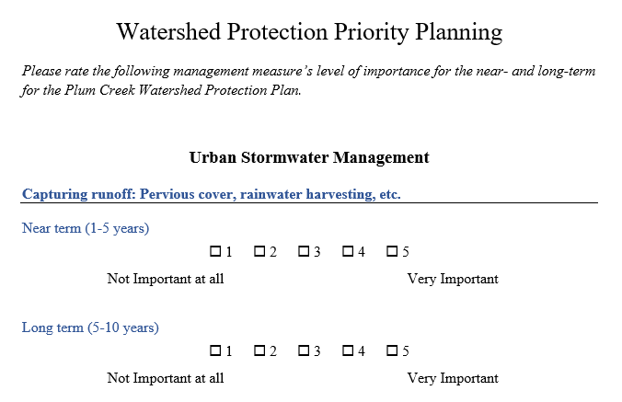
Steering Committee Members Activity

Slide 17
THANK YOU!
Christina Lopez
clopez@plumcreekwatershed.org
830-557-7358
Plumcreekwatershed.org
Funding for the development and support of the Plum Creek Watershed Protection Plan is through a Clean Water Act grant provided by the Texas State Soil and Water Conservation Board and U.S. Environmental Protection Agency.

