Slide 1
Plum Creek Watershed Partnership
Steering Committee Meeting
Lockhart State Park Recreation Hall
May 30th, 2024

Slide 2
Steering Committee Membership: Voting Action Need
Per the ground rules, to add and/or replace a new member, the new member must be approved by majority of the current members.
For the removal of inactive member, three unexcused absences without coordination with the facilitator, constitutes a resignation from the Steering Committee. We will vote to affirm the decision to resign inactive member, in good faith.

Slide 3
Work Group Meeting Updates
This past quarter the Civil Work Group met. Due to scheduling conflicts, the Natural Environment Work Group was unable to meet. Here are some highlights:
The Civil Work Group
Development concerns were discussed and examining impervious cover limits and road construction parameters
Discussed potential new community / private partnerships
Continued conversation on a Plum Creek focused infrastructure planning guide/training
For the Natural Environment Work Group of only three members, it would be good to have at least one or two more added to this group.

Slide 4
One Water in
Plum Creek
The Water Research Foundation defines One Water as an integrated planning and implementation approach to managing finite water resources for long-term resilience and reliability, meeting not only the economic needs but also community and ecosystem needs.
One Water is a synergized approach to traditional water management, from wastewater to drinking water to stormwater management.
Plum Creek has the opportunity to engage in this effort as it becomes more known here in Texas.
Planning with a Purpose

Slide 5
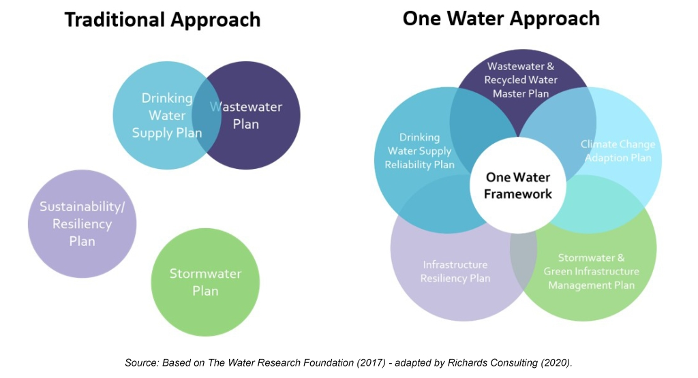
One Water in Plum Creek
Benefits of adopting One Water for Plum Creek
Synergy with our efforts and partner projects. An intentional effort, linking these sectors together.
Joining the nation/ state/ regions efforts
80 One Water communities nationwide. 4 are here in Texas, closest New Braunfels.
Bolsters what we are already doing while highlighting the triple bottom line - community, economy, and environment

Slide 6
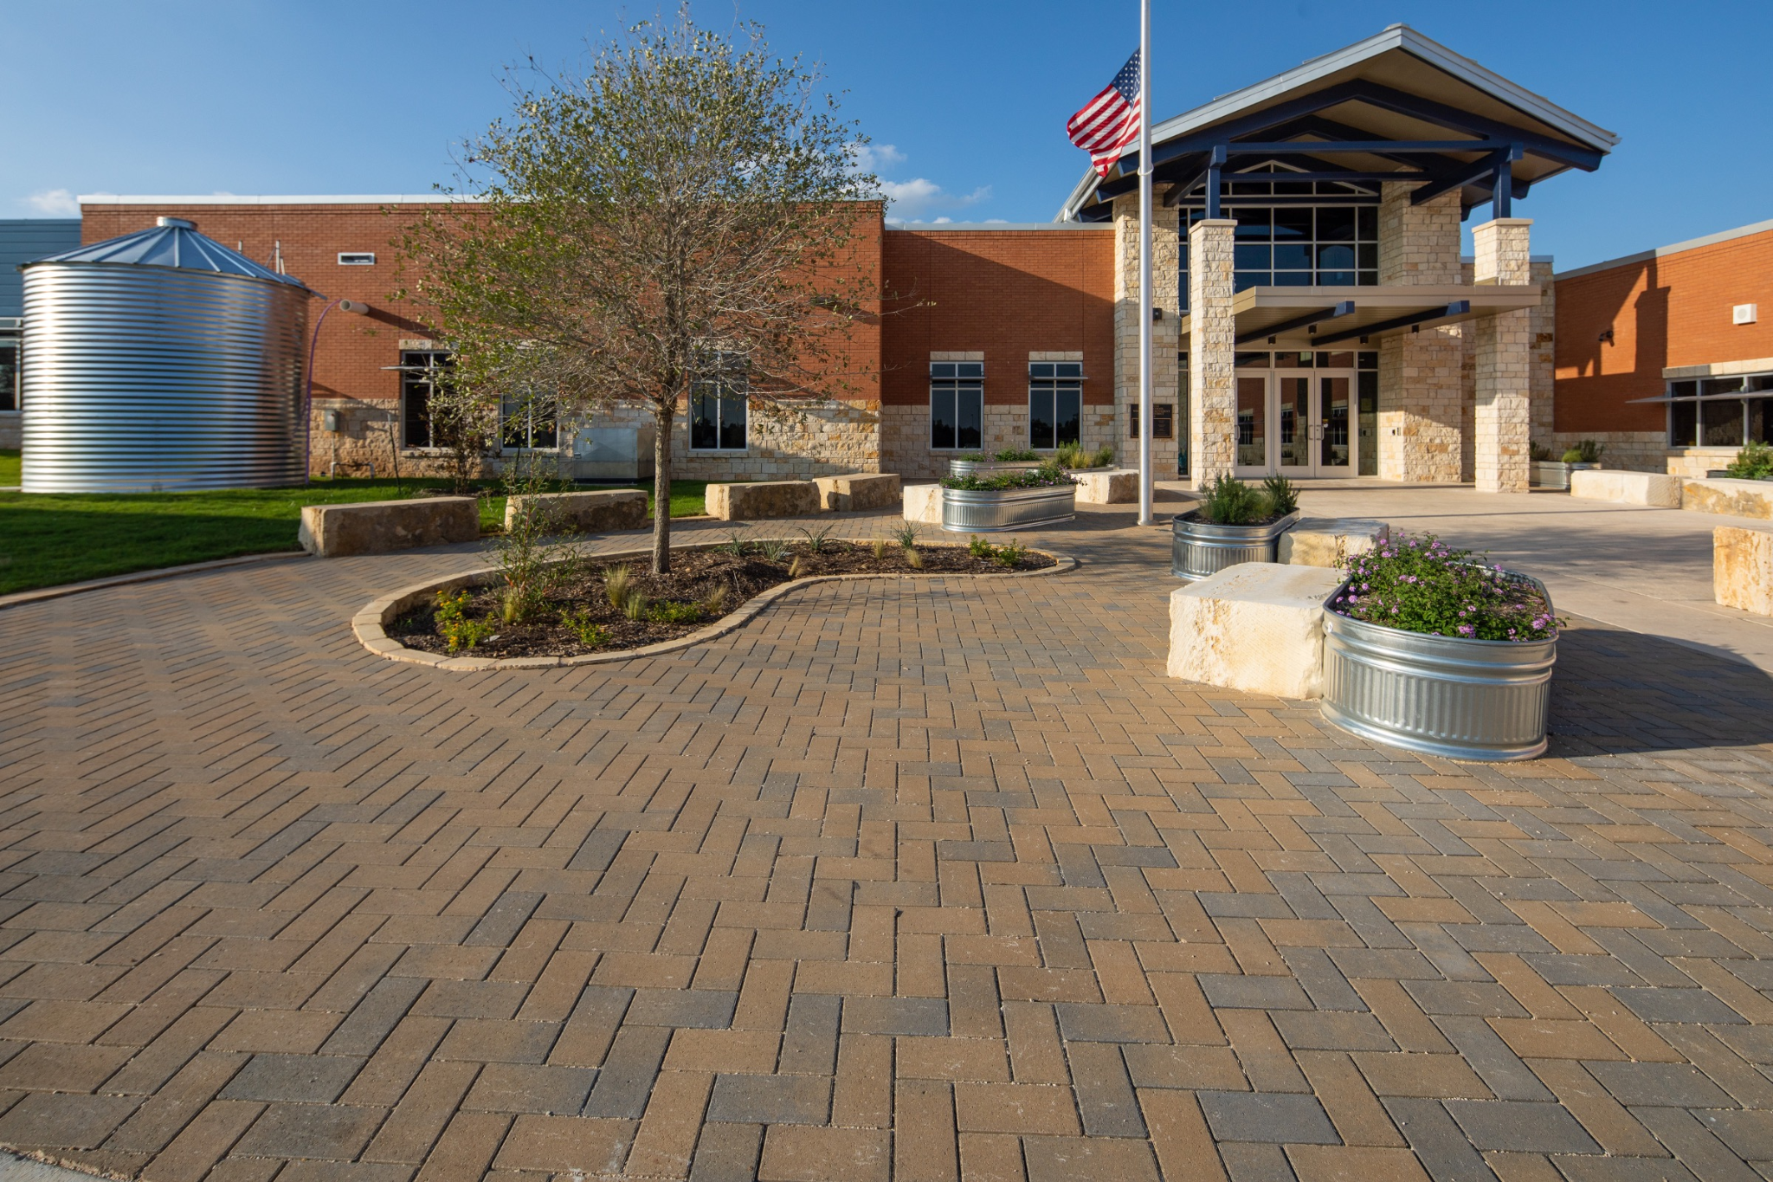
One Water in Plum Creek
How One Water could look in the Plum Creek Watershed
We can adopt this in our own mission and our WPP implementation
Focused one-off projects/ new constructions
Formal adoption of One Water by partners
City/County resolution or proclamation to have One Water included in relevant planning
Establish One Water Coordinator position in the watershed or with specific partner
Blue Hole Primary Wimberly, a One Water school design

Slide 7
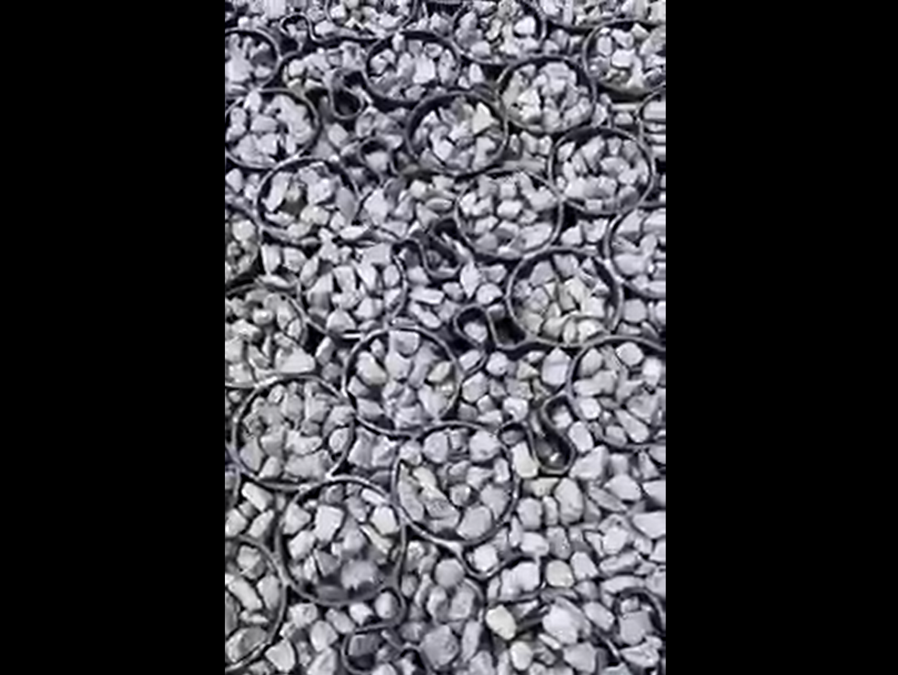
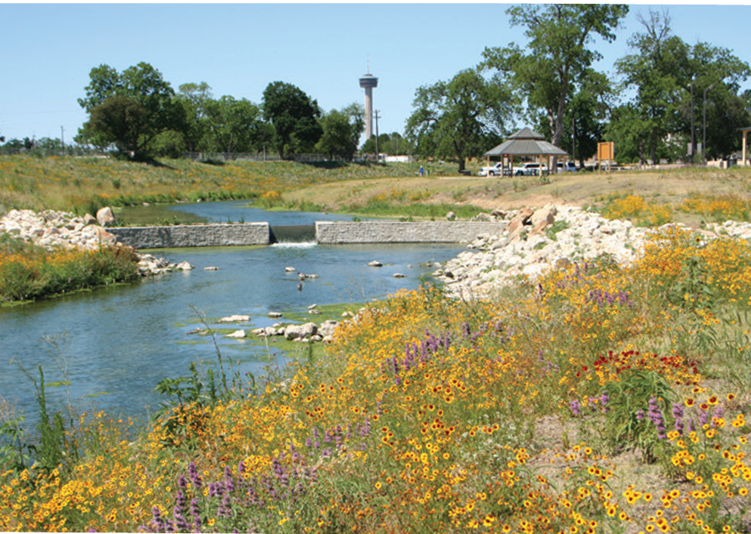
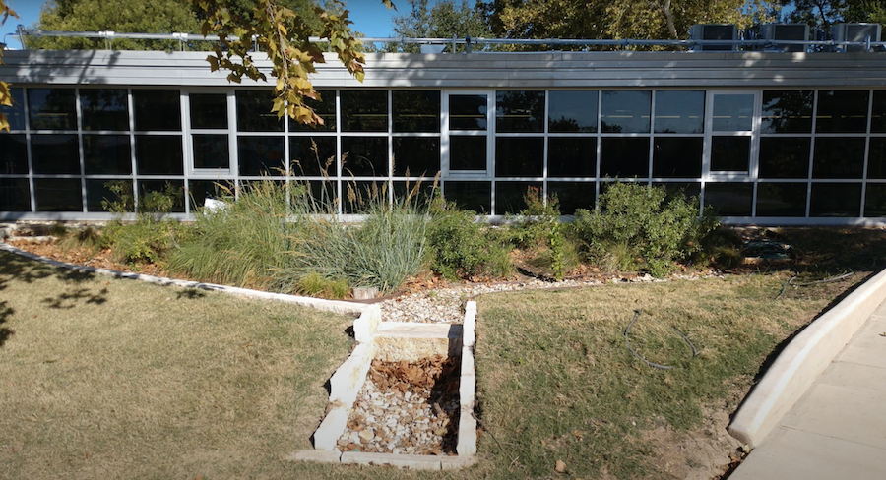
One Water in Plum Creek
One Water presents a menu of options that can be incorporated into any project or planning process.
Reilly Elementary School Rain Garden. Photo by Austin Watershed Protection Department.
La Vernia City Park Permeable Pavement
Brooks Campus LID redevelopment
Pictures: One Water in the Hill Country and Facebook

Slide 8
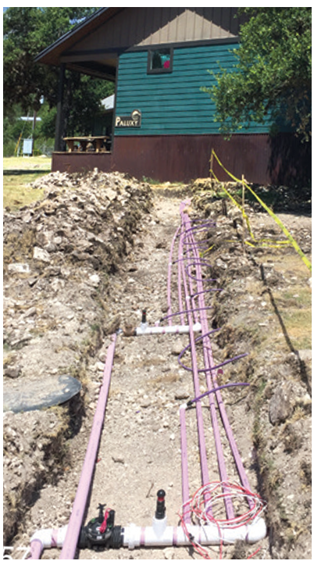
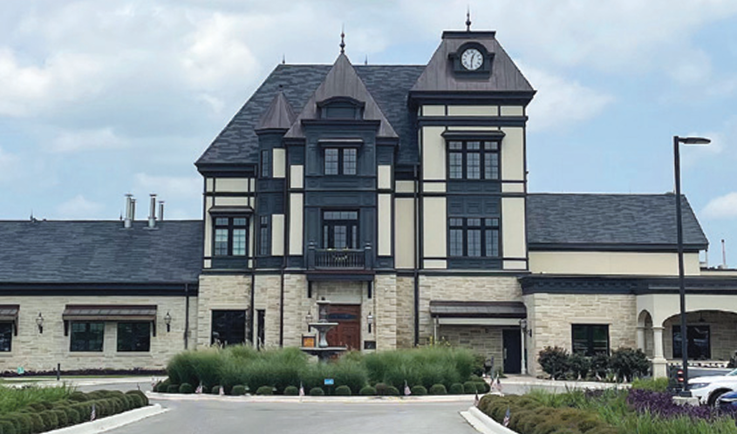
One Water in Plum Creek
Left: Altstadt Brewing, zero discharge wastewater system
Right:Camp Eagle, Wastewater reconstruction
Pictures: One Water in the Hill Country

Slide 9
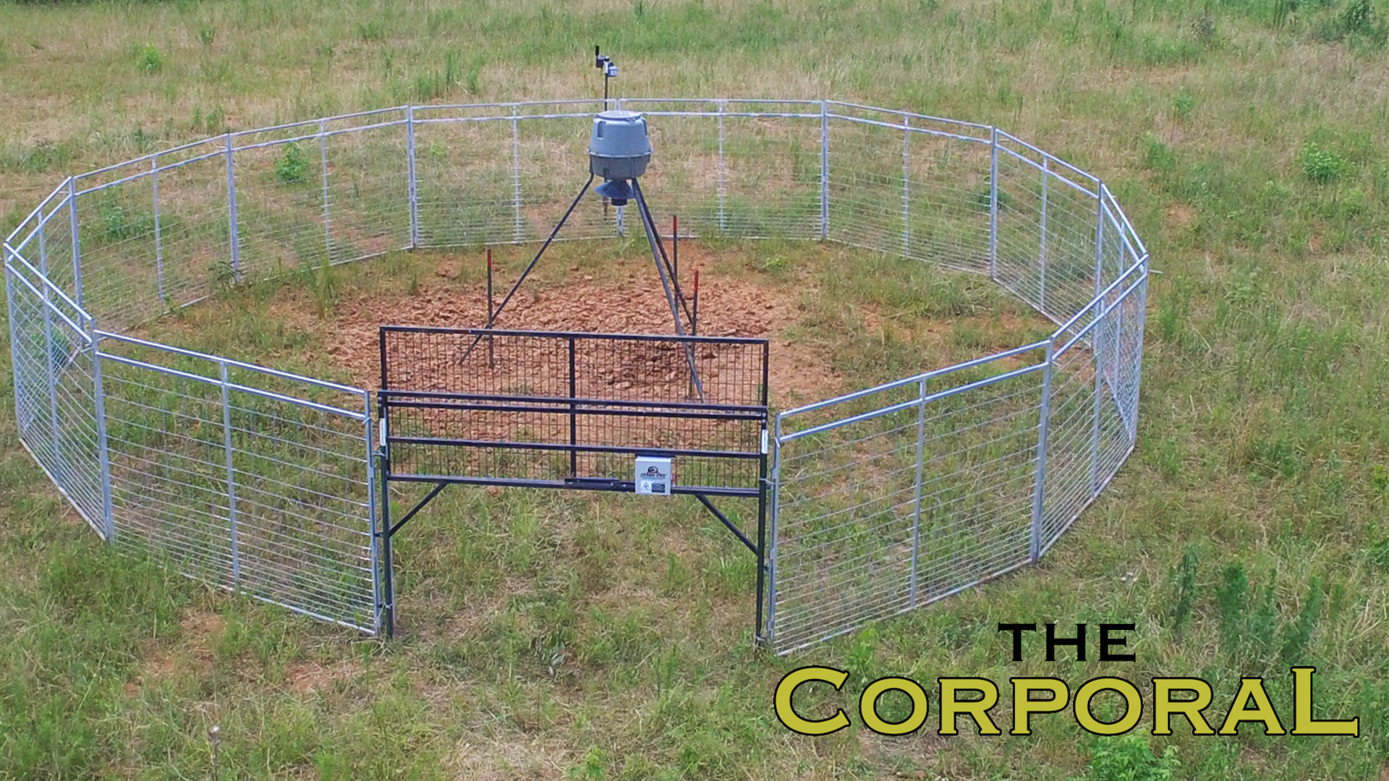
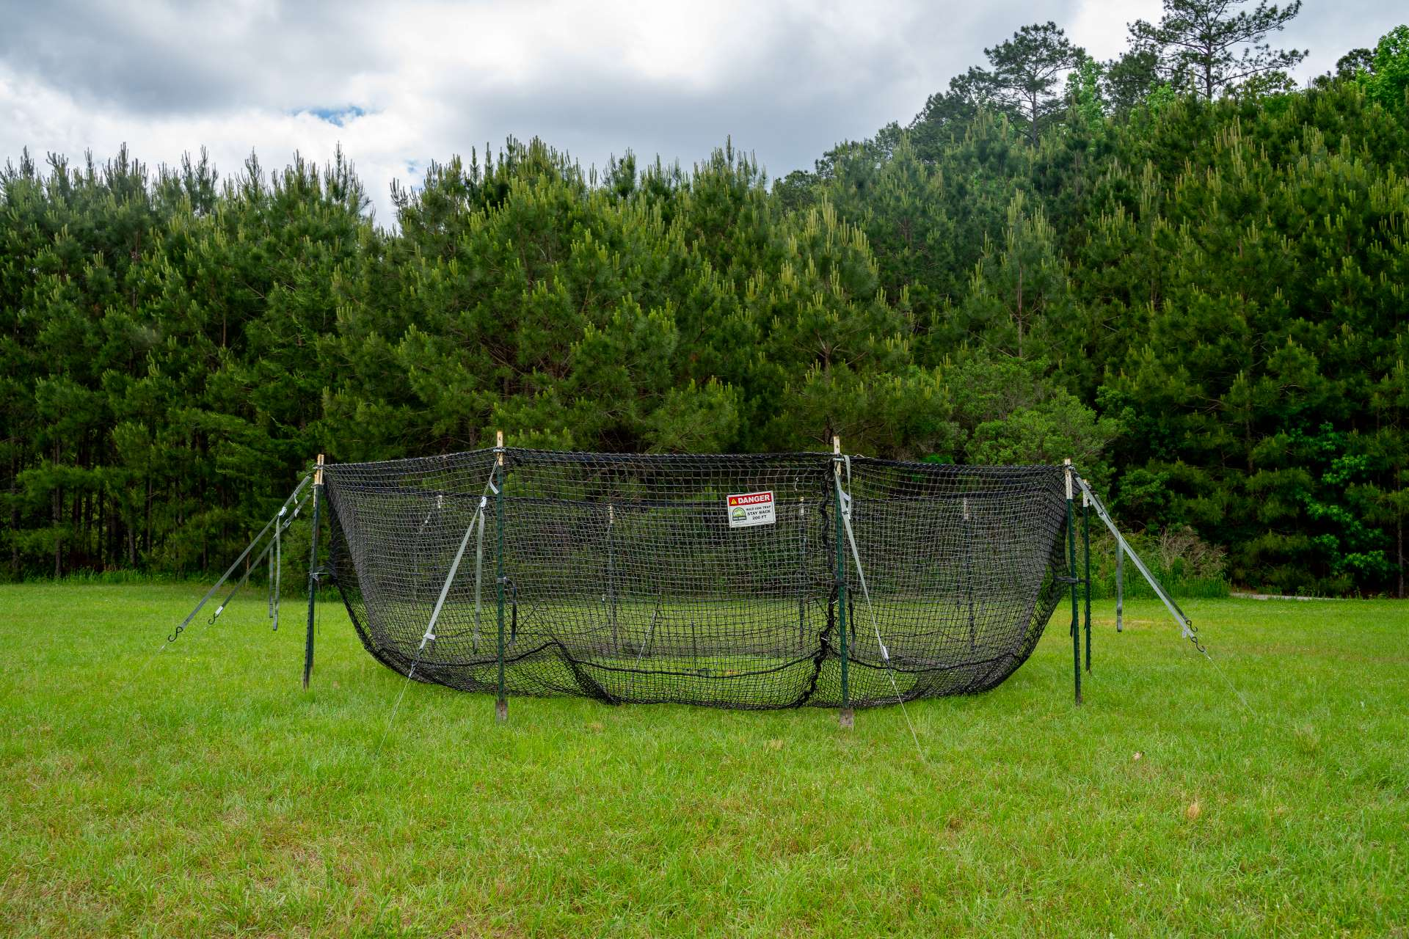
Feral Hog Trap Loan Program Proposal
Texas A&M AgriLife Extension - Wildlife Services did not award Caldwell County for the Feral Hog Abatement Grant for FY24. This has triggered looking into alternative solutions that are not dependent on this one grant. Looking forward:
Drafting a program proposal and project design
Identifying our responsibilities, project partners and personnel needs
Determining stakeholder needs
Jager Pro smart corral trap system
Pig Brig net trap system

Slide 10
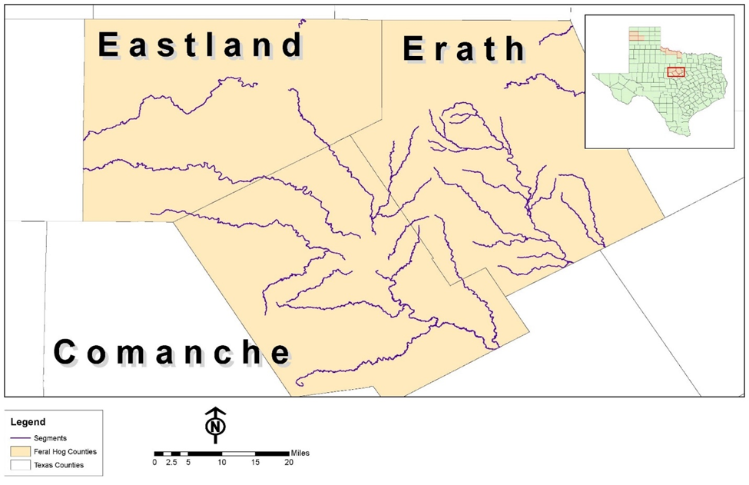
Feral Hog Trap Loan Program Proposal
Some specifics
PCWP could only be a supporting partner
Planned out for a two year pilot period
Smart trap/ traps with cameras is mandatory
Most cost are upfront with equipment
Upper Leon Soil Water Conservation District

Slide 11
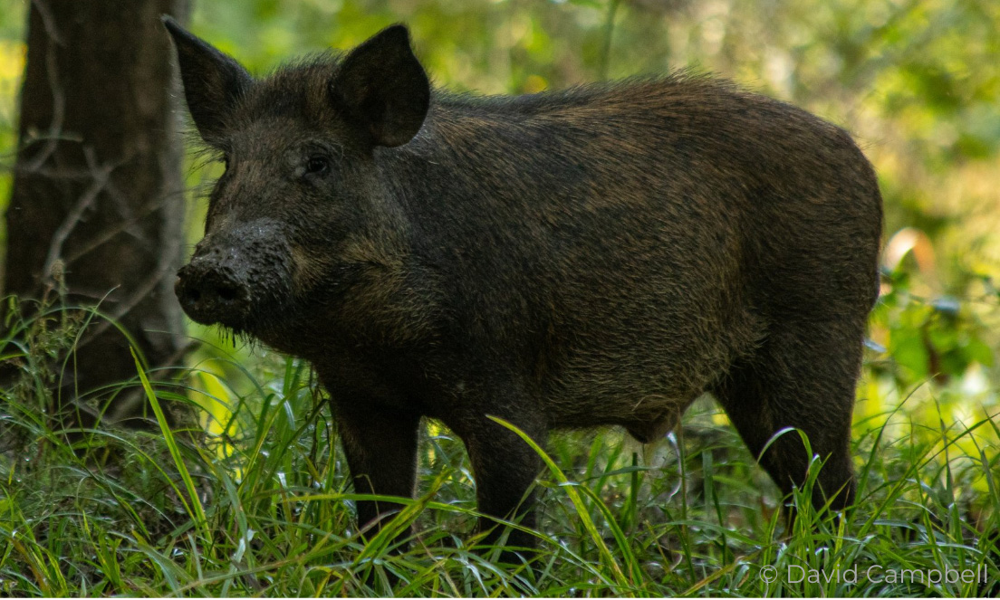
Feral Hog Trap Loan Program Proposal
Some hurdles
Funding/ continued funding
Service and maintenance costs
Landowner participation & engagement
There is need for a technician / committed personnel
Lender/participation contracts
Coping with feral hogs

Slide 12
Next Meeting
Next meeting will be a Public Stakeholder meeting in July 2024.
What topics or presenters would you like to have for the upcoming Public Stakeholder meeting?

Slide 13
THANK YOU!
Sean Melvin
smelvin@plumcreekwatershed.org
830-557-7358
plumcreekwatershed.org
Funding for the development and support of the Plum Creek Watershed Protection Plan is through a Clean Water Act grant provided by the Texas State Soil and Water Conservation Board and U.S. Environmental Protection Agency.

