Slide 1
Plum Creek Watershed Partnership
Steering Committee Meeting
Lockhart State Park Recreation Hall
July 13th, 2023

Slide 2
New Members and Alternates
Let us vote in new members to the Steering Committee and selected alternates.
Steering Committee Members
Karen Gallaher, City of Uhland
BJ Westmoreland, Caldwell County
Alternates
Alan Burkland, Plum Creek Conservation District
Keshav Gnawali, City of Kyle
Hoppy Haden, Caldwell County
Marla Heger, Caldwell-Travis SWCD
Richard Steinbrink, Hays SWCD

Slide 3
Work Group Meeting Highlights
This past month both the Civil Work Group and Natural Environment Work Group meet. Here are some highlights:
The Civil Work Group
Investigating new ways for addressing point source pollution issues
Looking into developing a stream model for Plum Creek
Natural Environment Work Group
Priority is landowner outreach and providing educational/ public participation opportunities
Engage developers in the watershed
Both work groups are interested in what unique updates can be brought to the WPP. Both are planning to meet with this quarter.

Slide 4
Watershed Protection Plan Biennial Update
The next biennial update for the WPP is fast approaching. At this time, let us discuss what unique items to include for the coming update.
Measures and Milestones
Revisit load reduction
What been done in 10 years and what could be done in next 10 years?
Water quality reporting
How do we want to analyze and show our data?
10 year trends, 5 year trends
Wet vs Dry trends
Notes:
Last update looked at data from 2008 to Q3 of 2021

Slide 5
Plum Creek Watershed Partnership
Public Stakeholder Meeting
Lockhart State Park Recreation Hall
July 13th, 2023

Slide 6
Welcome to the Public Stakeholder Meeting!
Meet the Plum Creek Watershed Partnership and its Steering Committee!

Slide 7
The Plum Creek Watershed Partnership
The Partnership is composed of 12 partners which include:
Hays County
Caldwell County
Guadalupe-Blanco River Authority
City of Kyle
City of Buda
City of Lockhart
City of Uhland
City of Luling
Hays County Soil & Water Conservation District
Caldwell-Travis Soil & Water Conservation District
Plum Creek Conservation District
Aqua Water Supply Corp.
An Interlocal Agreement (ILA) was first established in 2011 and is being renewed again this year. The ILA serves to allow local partners to provide the required 40 percent match each year for the Clean Water Act Section 319(h) grant. Through the efforts of our partners, the Partnership remains at the forefront of water quality management and has played a key role in watershed stewardship in Texas.

Slide 8
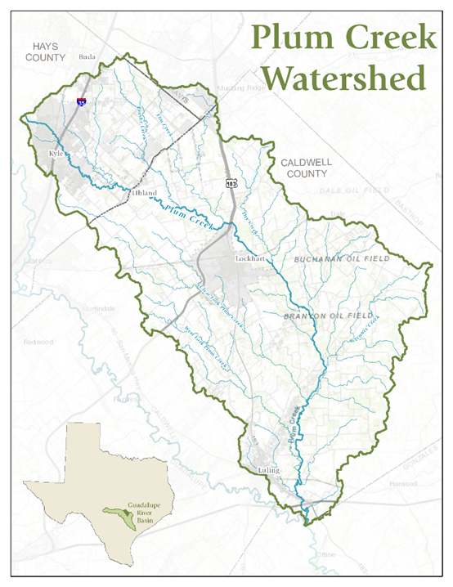
Plum Creek Watershed
The watershed
Stretches across Hays and Caldwell County and the cities of Kyle, Buda, Uhland, Lockhart and Luling
~400 square miles with Plum Creek measuring 52 miles
Is a significant tributary to the San Marcos River
The issues in the watershed
Impaired for E. coli bacteria (since 2004)
Concerns for Nitrate Nitrogen, Ammonia Nitrogen, Total Phosphorus, impaired macrobenthic community, impaired fish community and impaired habitat

Slide 9
2022 Texas Integrated Report - Basin 18
Assessment Unit | Parameter | Status
1810_1 (near confluence with San Marcos River) | E. coli (Geomean) Nitrate (nutrient) Total Phosphorus Fish Community Aquatic Habitat | Nonsupport (4b) Concern for screening level Concern for screening level Nonsupport Concern for screening level
1810_2 (~2.5 miles upstream of confluence with Clear Fork) | E. coli (Geomean) Nitrate (nutrient) Total Phosphorus Fish Community Aquatic Habitat | Nonsupport (4b) Concern for screening level Concern for screening level Use Concern Concern for screening level
1810_3 (~0.5 miles upstream of State Hwy 21) | E. coli (Geomean) Nitrate (nutrient) Total Phosphorus Ammonia Macrobenthic community Fish Kill Report | Nonsupport (4b) Concern for screening level Concern for screening level Concern for screening level Use Concern Use Concern
1810A_01 Town Branch (perennial stream in Lockhart) | E. coli (Geomean) Nitrate (nutrient) Dissolved O2 (grab) | Nonsupport (4b) Concern for screening level Concern for screening level
Since the implementation of the WPP, Plum Creek (segment 1810) continues to be recognized by the State of Texas as impaired for Primary Contact Recreation.
Here listed are the current impairments and concerns in Plum Creek as described in the 2022 Texas Integrated Report by TCEQ.
Highest average concentration of E. coli is at the 1810_3 segment
You can view the impaired stream information on TCEQ’s Surface Water Quality Segment Viewer. Link:
https://www.tceq.texas.gov/gis/segments-viewer
Notes:
Explained impaired…

Slide 10
The Plum Creek Watershed Protection Plan
The Plum Creek WPP is the watershed’s guide for reducing nonpoint source pollution and reducing the impacts of permitted point source issues.
The WPP was developed utilizing stakeholder input through public participation to provide a foundation for restoring water quality in Plum Creek and its tributaries.
WPP is intended to be a living document, adjusted to include new data, modified as conditions in the watershed change over time. As the WPP evolves it will be guided by local stakeholders themselves.

Slide 11
CITY OF KYLE MS4 STORMWATER PROGRAM

Slide 12
City of Kyle MS4 Program
MS4
Municipal Separate Storm Sewer Systems
Program
Stormwater

Slide 13
Stormwater Program History
1987 Clean Water Act Amended – EPA
1990 National Pollutant Discharge Elimination System (NPDES) for Phase I MS4 Permit (for Cities > 100,000)
1999 National Pollutant Discharge Elimination System (NPDES) for Phase II Permit (for Cities < 100,000)
Notes:
1987 EPA Designated municipal stormwater runoff as a discrete pollution source
1990 EPA delegated authority to Texas via the TNRCC/TCEQ to regulate & enforce the Phase I Permit (1998)
1999 MS4 authority delegated to Texas via the TCEQ to regulate & enforce the Phase II MS4 Permit (2007)

Slide 14
So why does stormwater matter?
In Kyle, stormwater flows directly to local waterways & is not treated
Stormwater pollution can negatively impact waterways & receiving streams
Trash and debris – harm wildlife and reduce aesthetic
Bacteria and other pathogens – health hazards
Household/commercial hazardous wastes – Poison wildlife and people, contaminated water
Sediment – harms aquatic habitat
Excess nutrients – Loss of oxygen

Slide 15
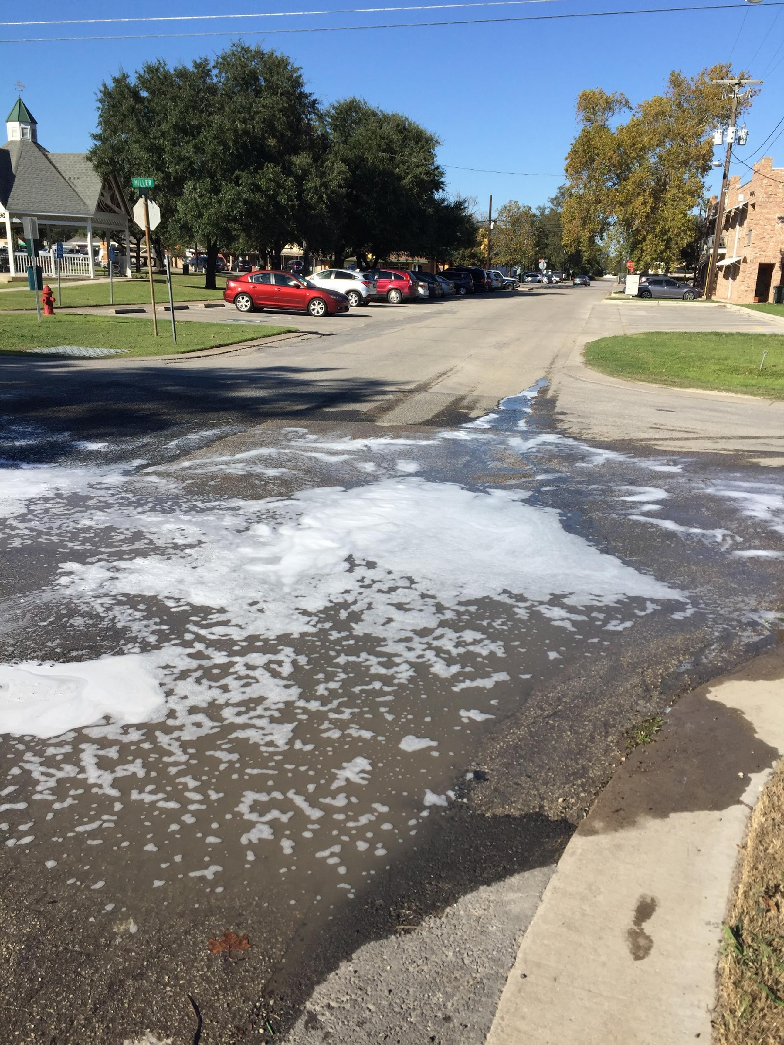
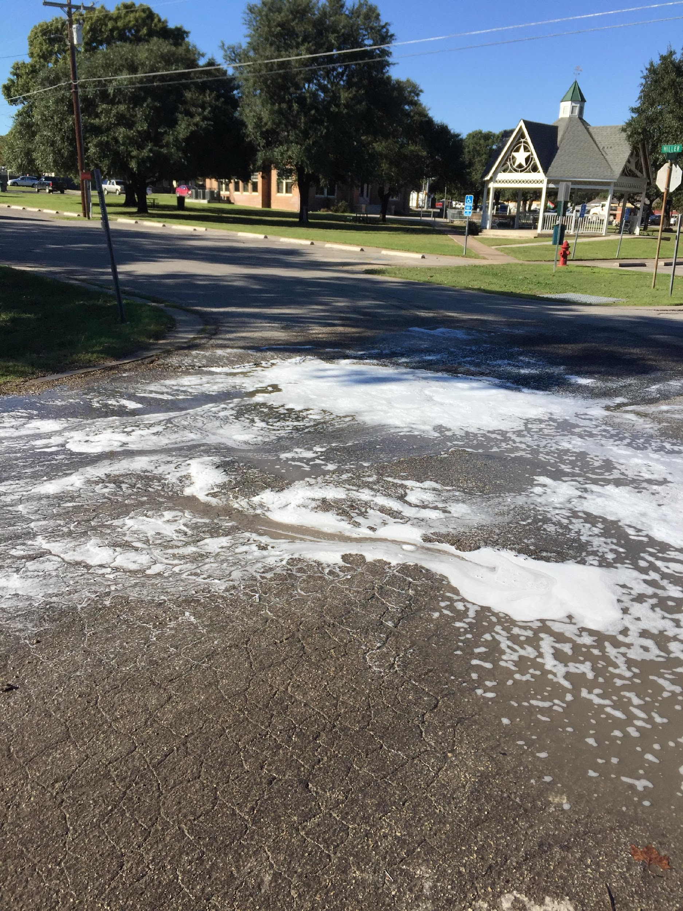
Examples of Stormwater Pollution

Slide 16
Stormwater (not so fun) Facts
Approximately 40% of the lakes in America are too polluted for fishing, aquatic life, or swimming
Each year 1.2 trillion gallons of untreated sewage, stormwater, and industrial waste are dumped into US water
Stormwater

Slide 17
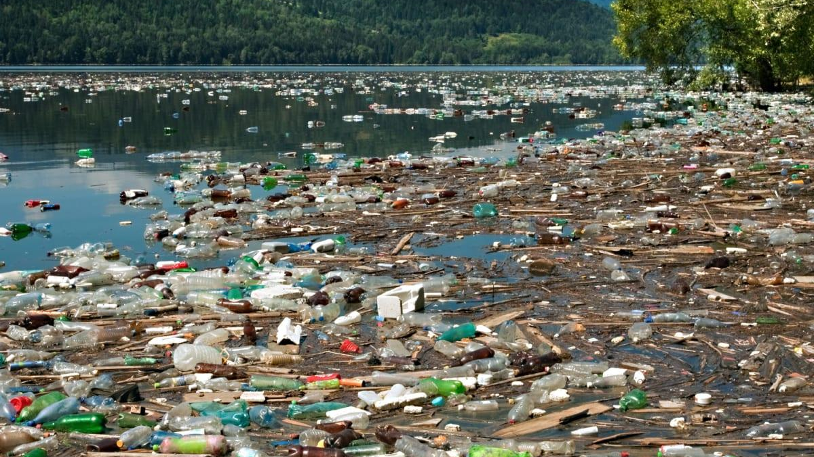
Stormwater

Slide 18
Stormwater Program
Kyle’s MS4 Stormwater Program
Stormwater

Slide 19
Stormwater Management Program Requirements
Level 1
Operators of traditional small MS4s that serve a population of less than 10,000 within a UA.
Level 2
Operators of traditional small MS4s that serve a population of at least 10,000 but less than 40,000 within a UA.
Level 3
Operators of traditional small MS4s that serve a population of at least 40,000 but less than 100,000 within a UA.
Level 4
Operators of traditional small MS4s that serve a population of 100,000 or more within a UA.
Notes:
Level 2 also includes all non‐traditional small MS4s such as counties, drainage districts, transportation entities, military bases, universities, colleges, correctional institutions, municipal utility districts and other special districts regardless of population served within the UA.

Slide 20
Stormwater Management Program Requirements
5 Minimum Control Measures:
Public Education, Outreach, and Involvement
Illicit Discharge Detection and Elimination (IDDE)
Construction Site Stormwater Runoff Control
Post Construction Stormwater Management in New Development and Redevelopment
Pollution Prevention and Good Housekeeping for Municipal Operations
Best Management Practices:
The City has 34 BMPs required for compliance with the City’s program

Slide 21
Stormwater Management Program Requirements
Public Education, Outreach, and Involvement
Best Management Practices:
Stormwater Management Page on City Website
Stormwater Outreach
Electronic Stormwater Communication
Storm Drain Inlet Markers
General Education of City Employees, City Inspectors and Elected and Appointed Officials
Preconstruction Developer/Builder/Engineer Education
School Education and Outreach
Comply with State and Local Public Notice Requirements
Public Meeting(s)
Stormwater Hotline and Online Complaint Submission
Bulk Waste Cleanup and Pickups
Household Hazardous Waste (HHW) Collection
City Park Maintenance
Plum Creek Cleanup
Pet Waste

Slide 22
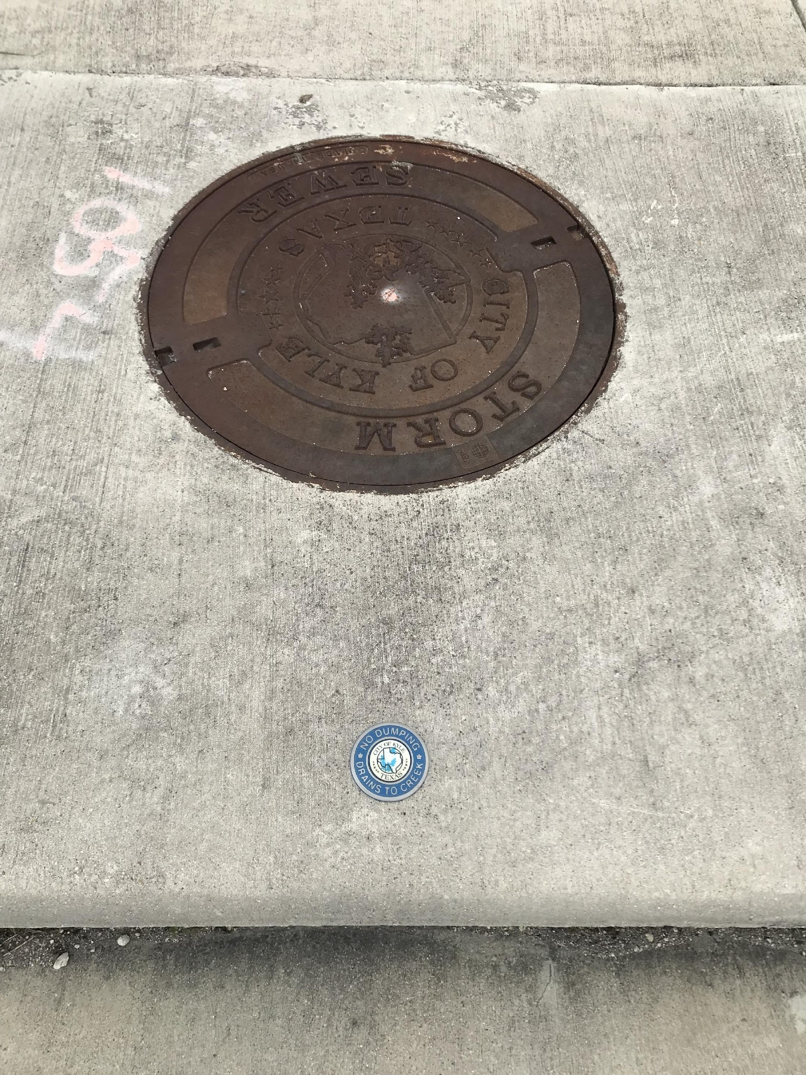
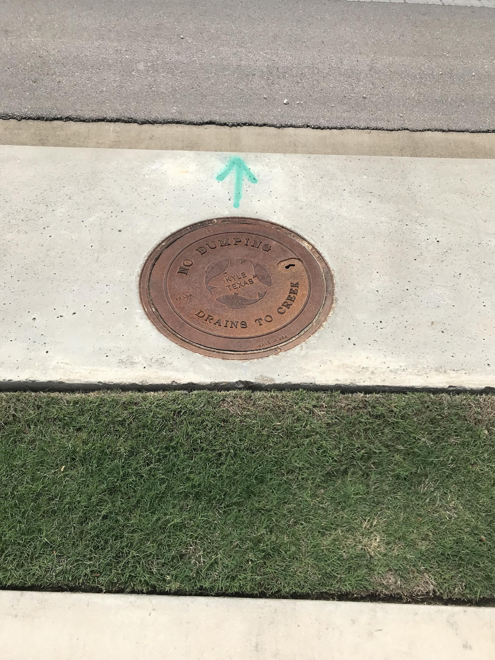
Notes:
Remember these pictures

Slide 23
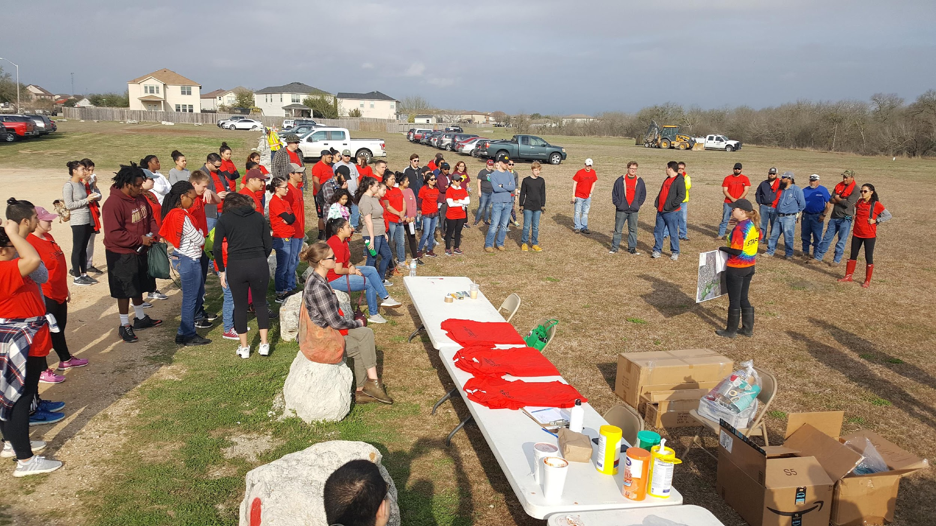
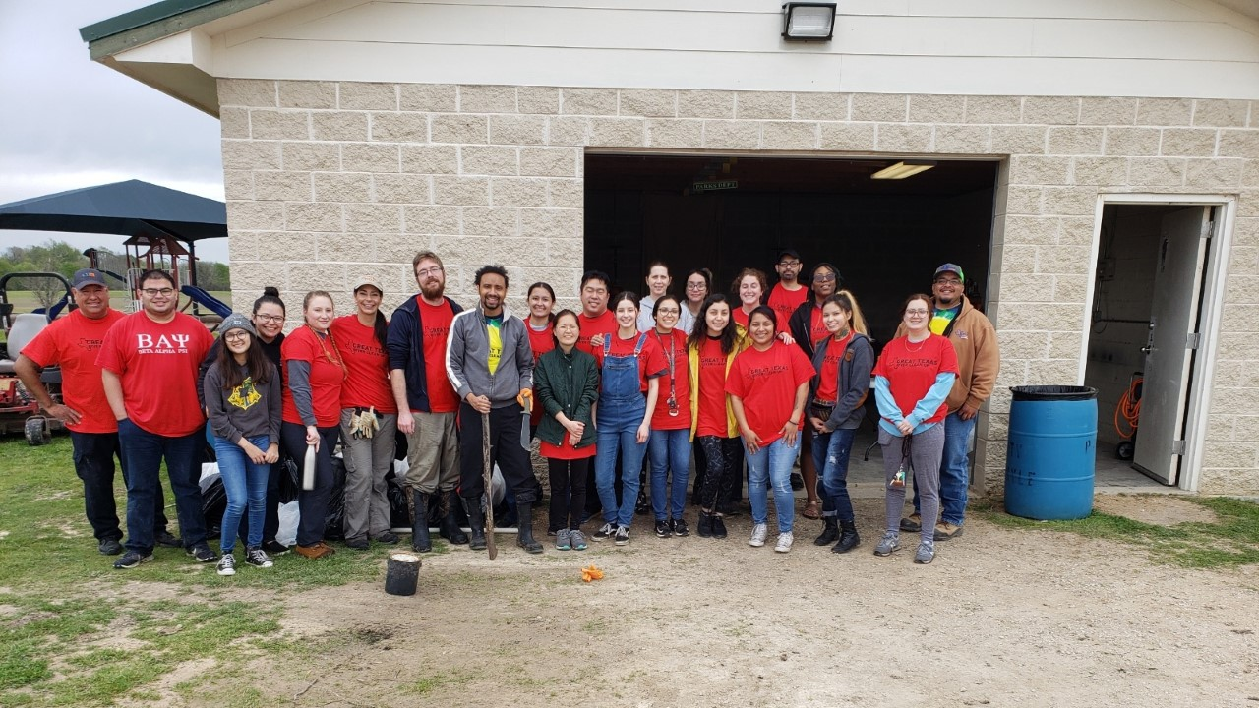
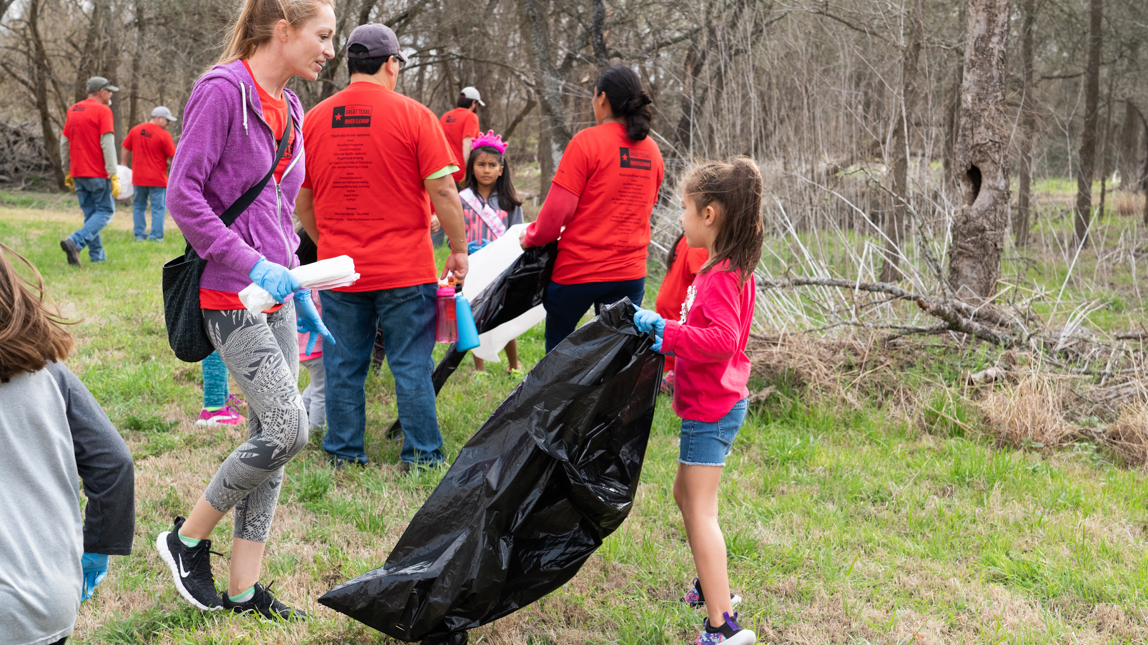
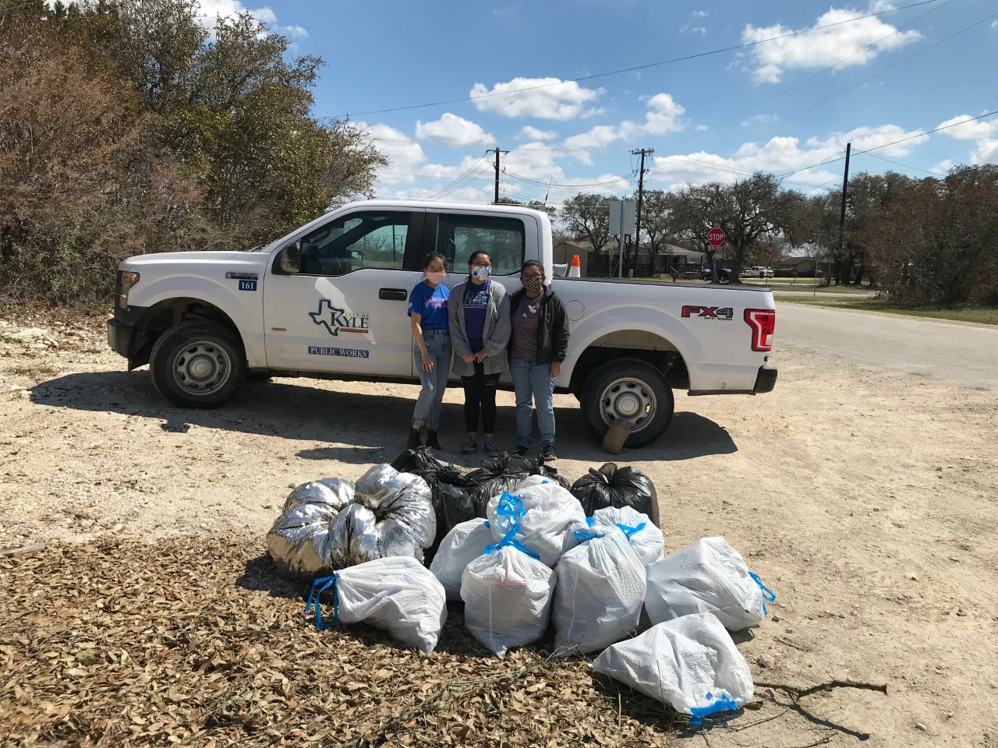

Slide 24
Stormwater Management Program Requirements
Illicit Discharge Detection and Elimination (IDDE)
Best Management Practices:
Stormwater Map
Illicit Discharge Ordinance
Illicit Discharge Inspections
Sanitary Sewer Line Maintenance and Inspection
Stormwater Sampling
Notes:
So what is an illicit discharge?

Slide 25
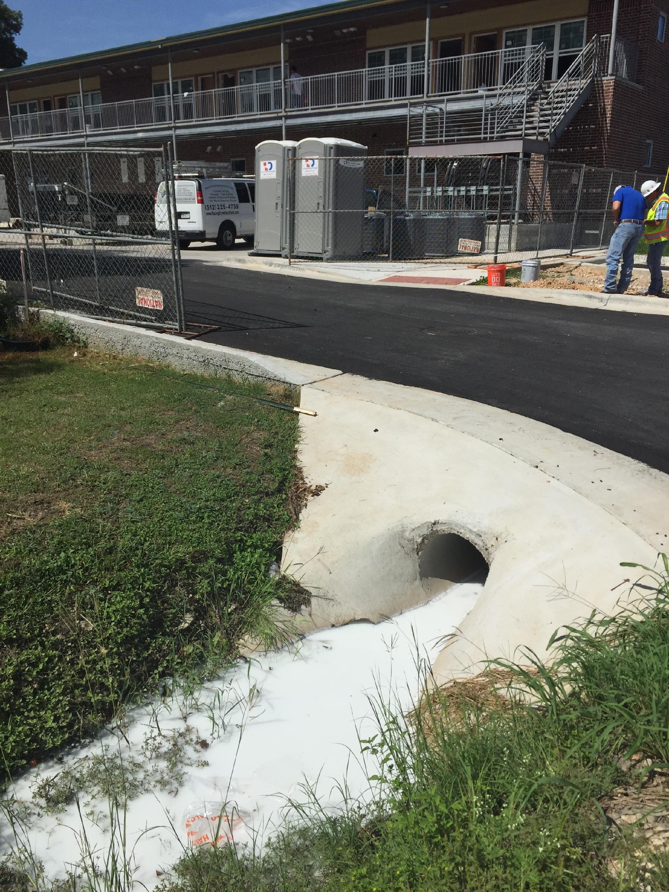
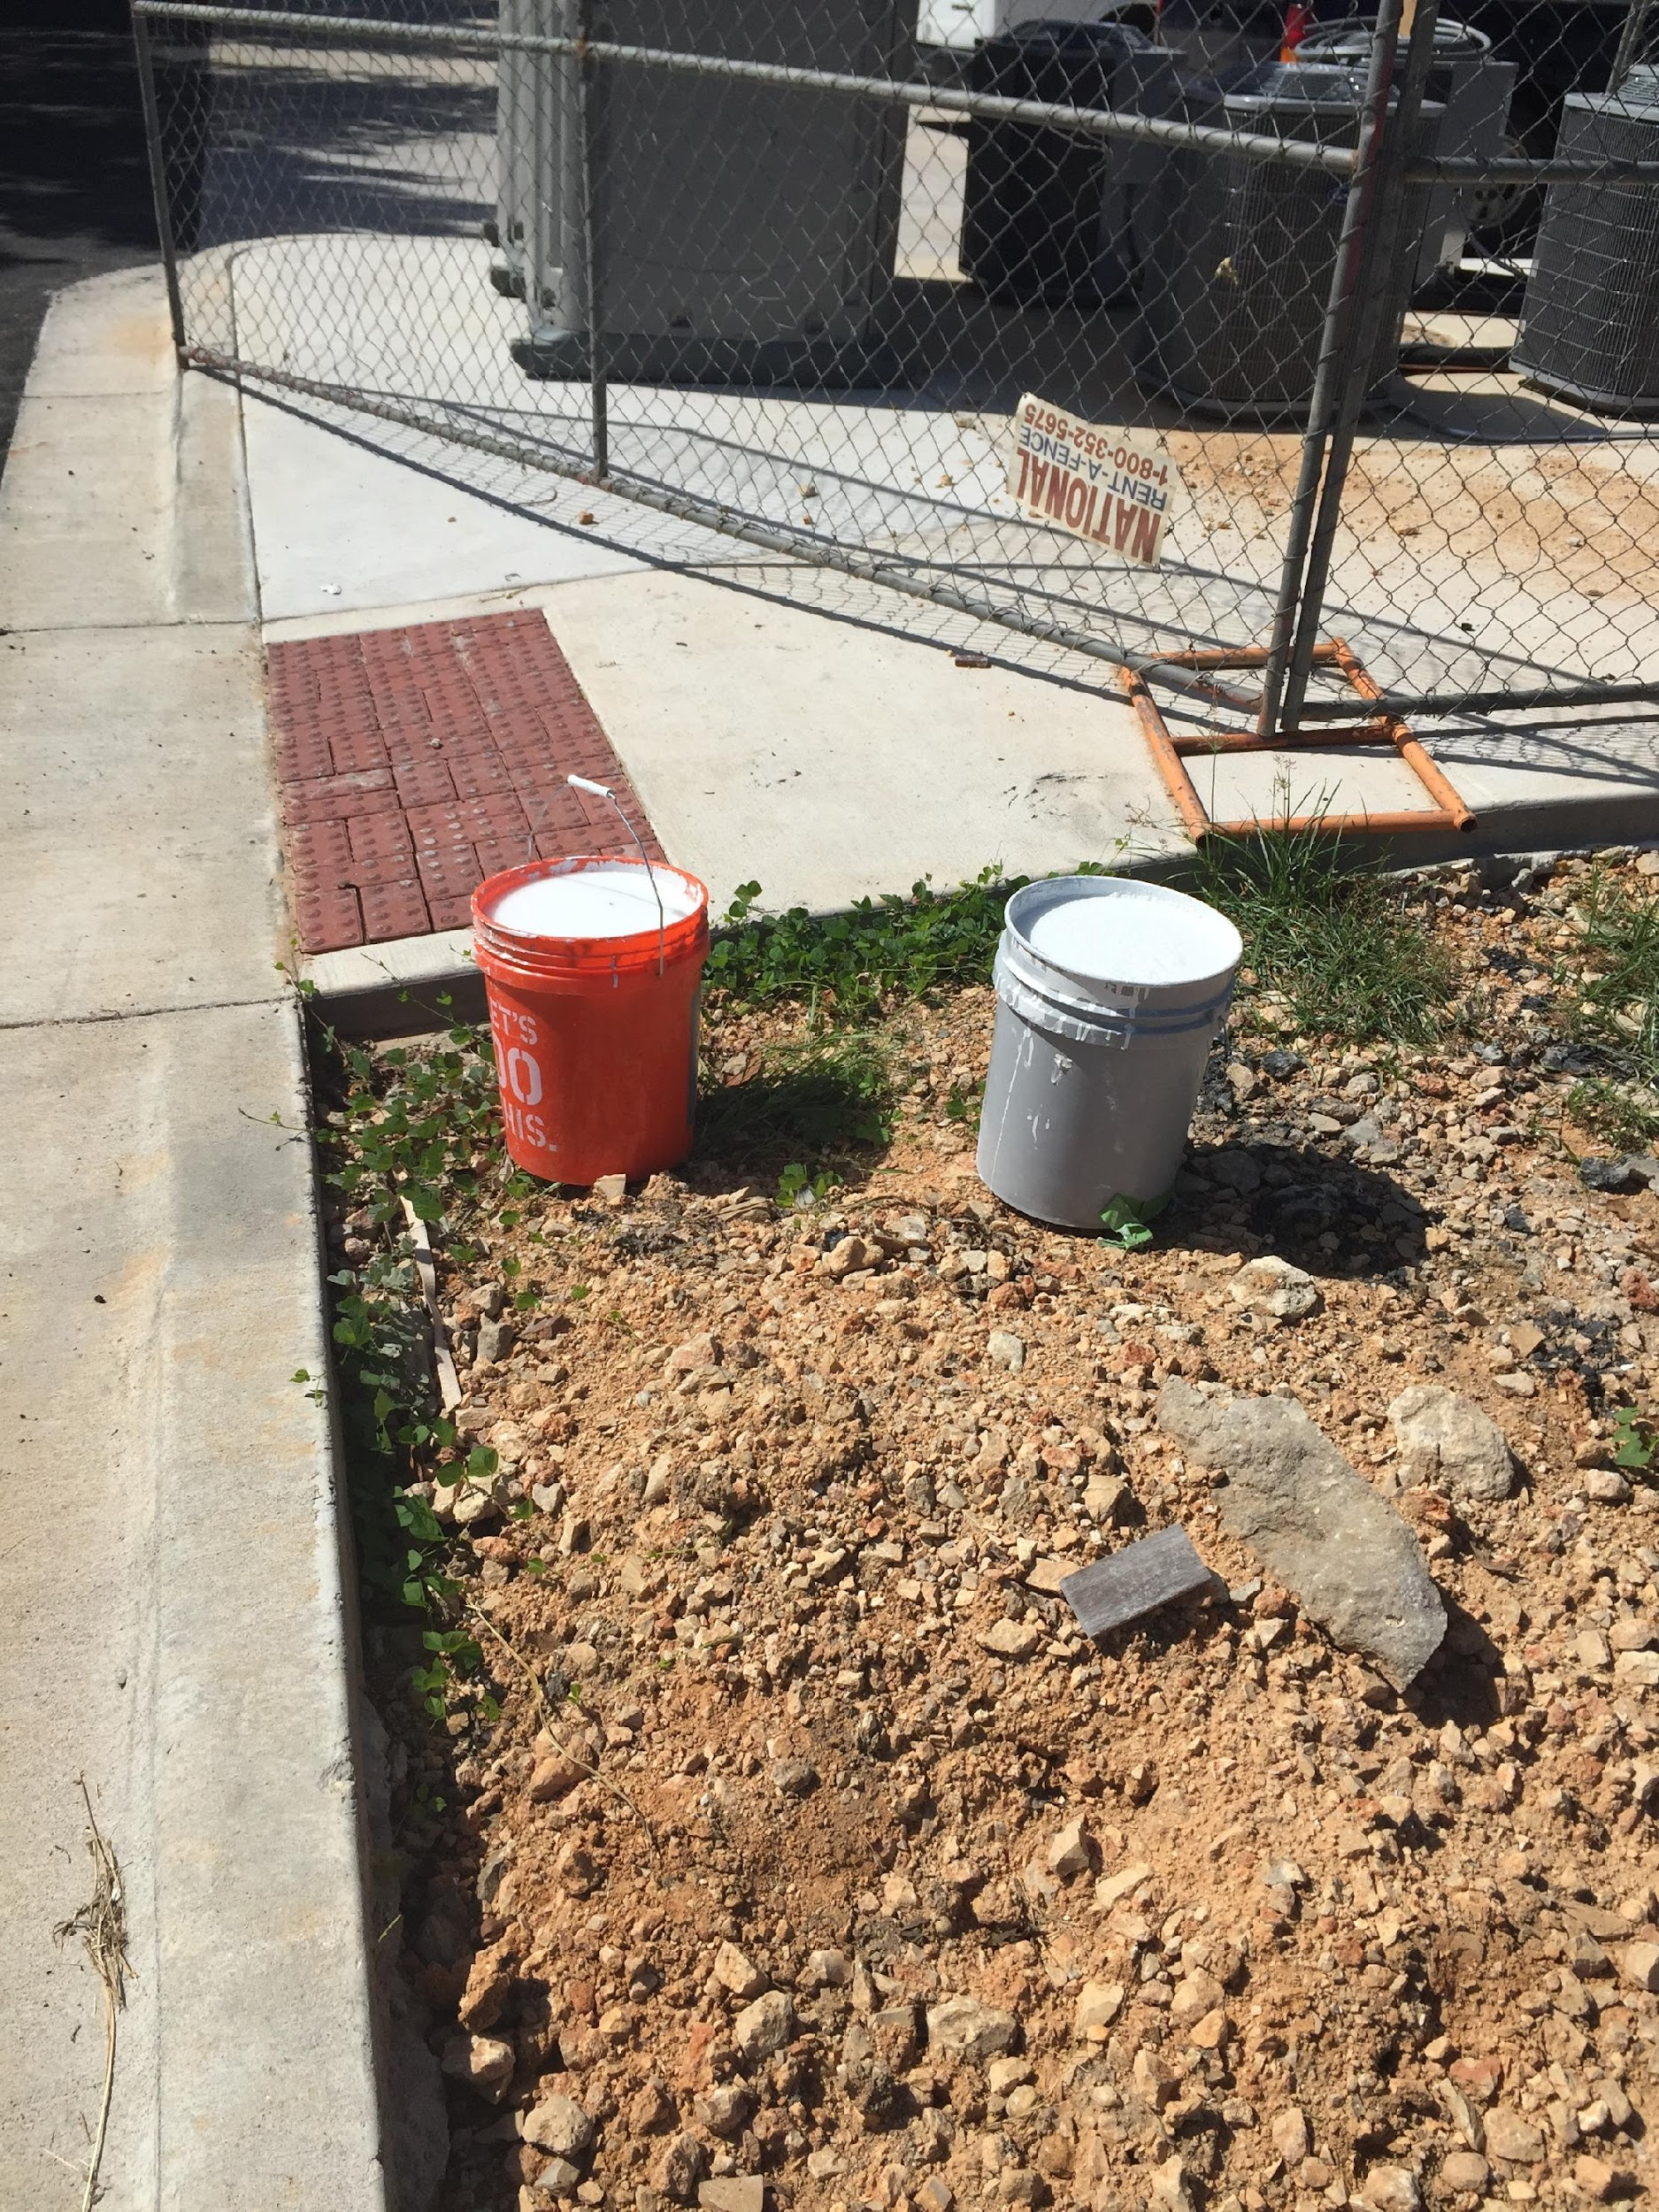
Notes:
Rule of thumb, if you wouldn’t want to swim in it, don’t dump it

Slide 26
Stormwater Management Program Requirements
Construction Site Stormwater Runoff Control
Best Management Practices:
Construction Site Stormwater Runoff and Erosion Control Ordinance
Site Plan and Construction Plan Reviews
Active Construction Site Inspections

Slide 27
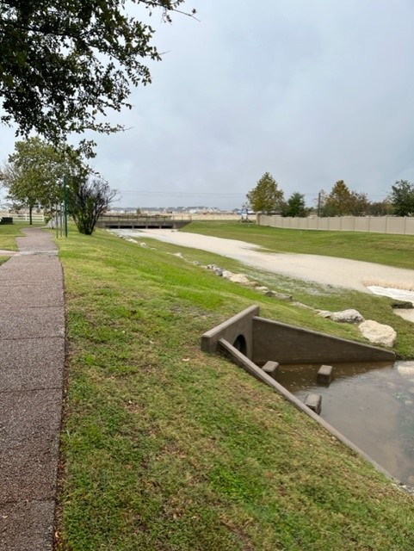
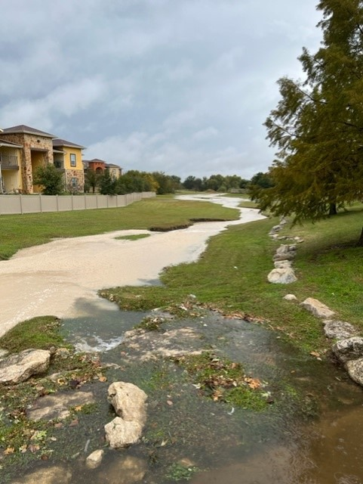
Notes:
What is causing this color water?

Slide 28
Stormwater Management Program Requirements
Post-Construction Stormwater Management in New Development and Redevelopment
Best Management Practices:
Post-Construction Stormwater Runoff Control Ordinance
Post-Construction Structural and Non-Structural BMPs
Structural Control Maintenance
Land Use Plan

Slide 29
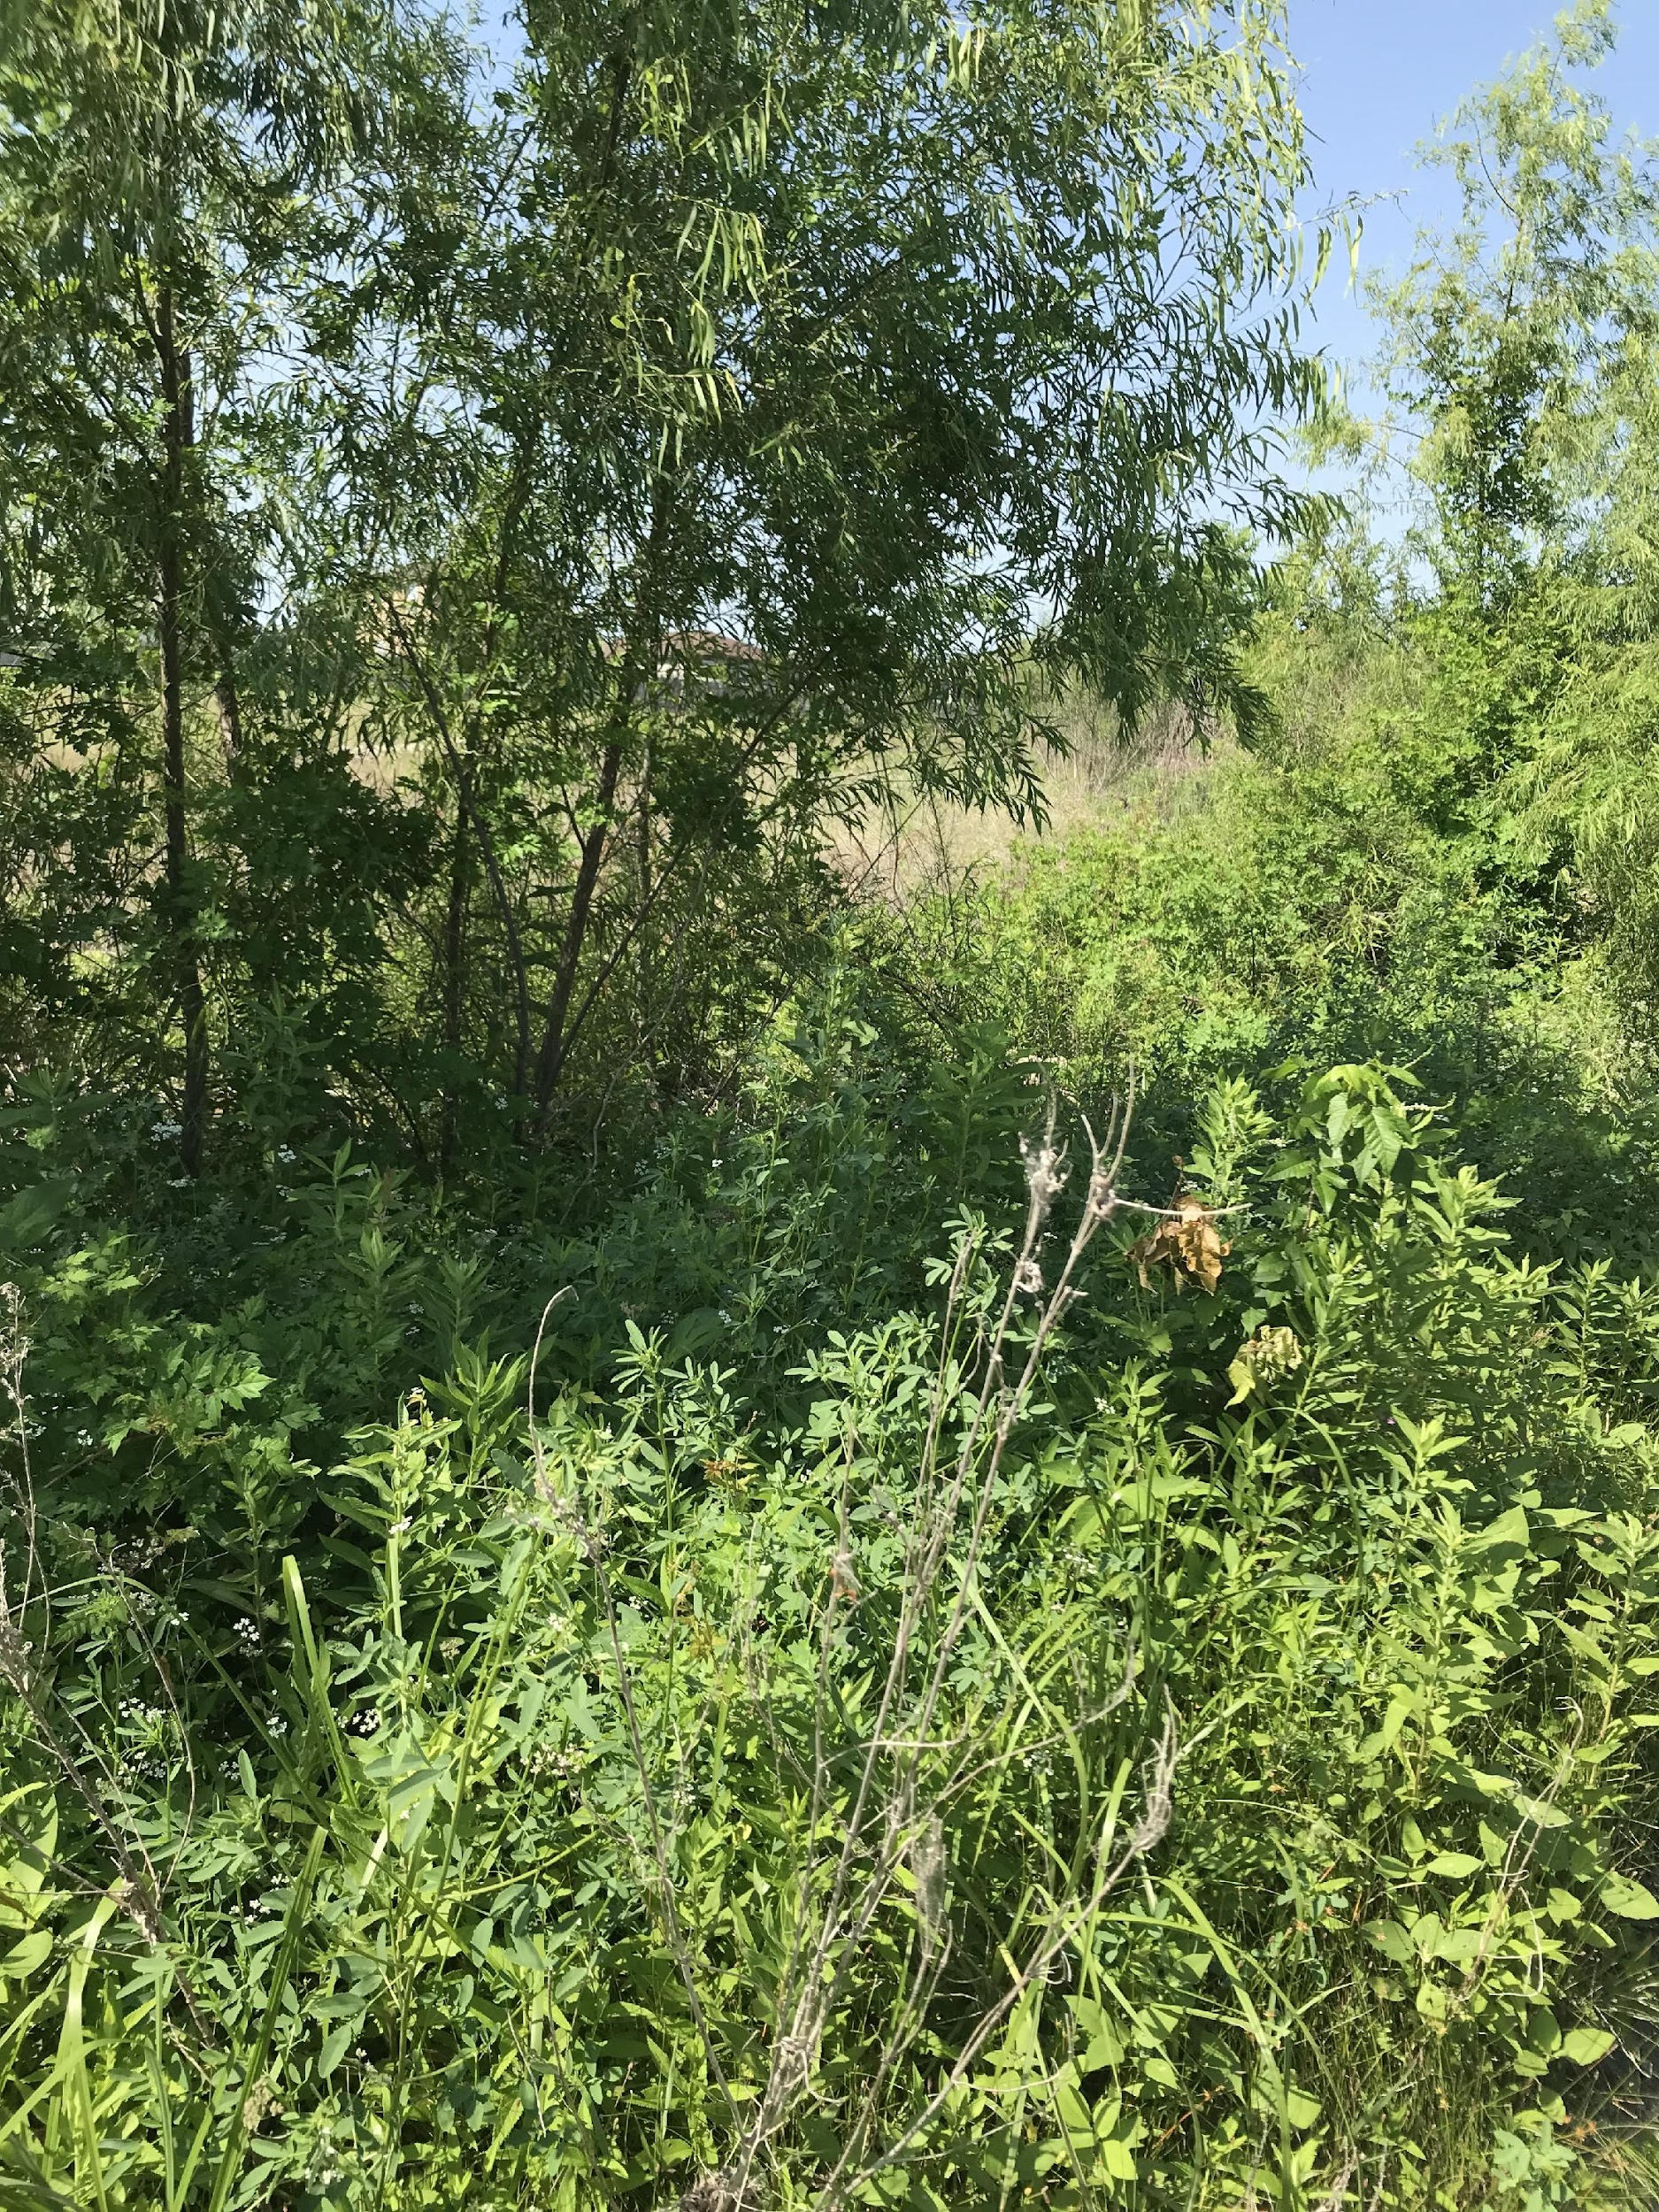
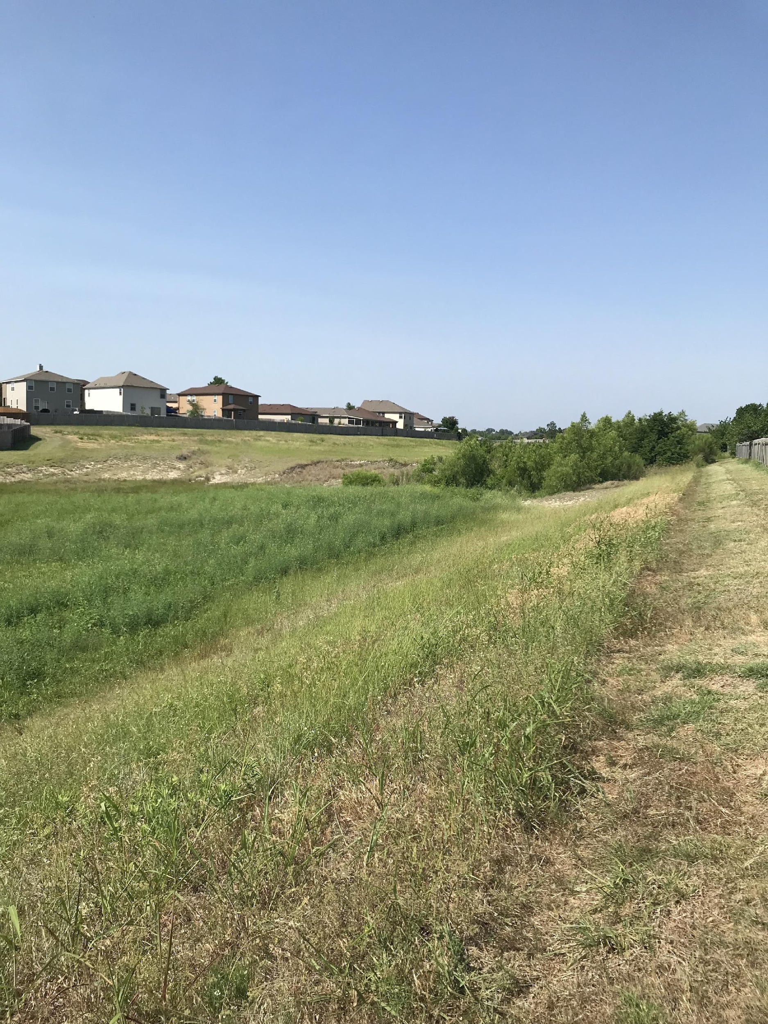

Slide 30
Stormwater Management Program Requirements
Pollution Prevention and Good Housekeeping for Municipal Operations
Best Management Practices:
Municipal Operations and Industrial Activity Operations and Maintenance Program
Training Program for City Employees to Minimize Runoff Caused by Municipal Operations
Chemical Applications and Materials Management
Storm Drainage System Maintenance
Street Sweeping
Spill Response
Disposal of Collected Storm Drainage System Waste

Slide 31
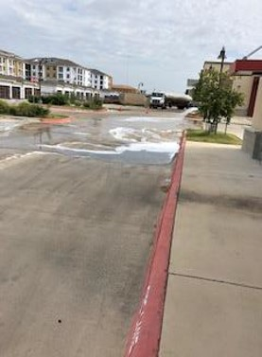
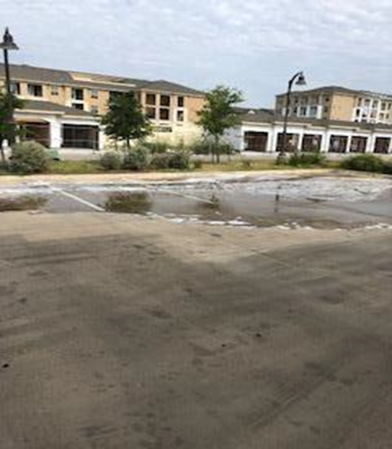
Notes:
1800 gallon Ethanol spill

Slide 32
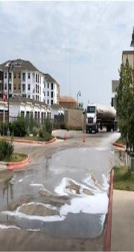
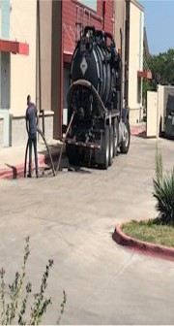

Slide 33
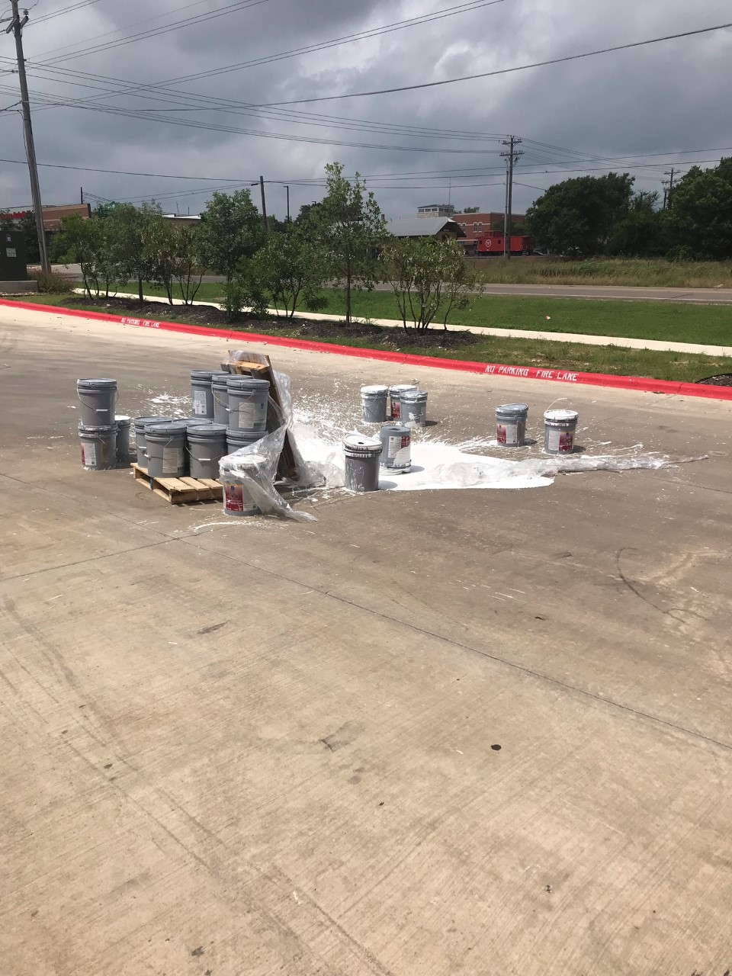
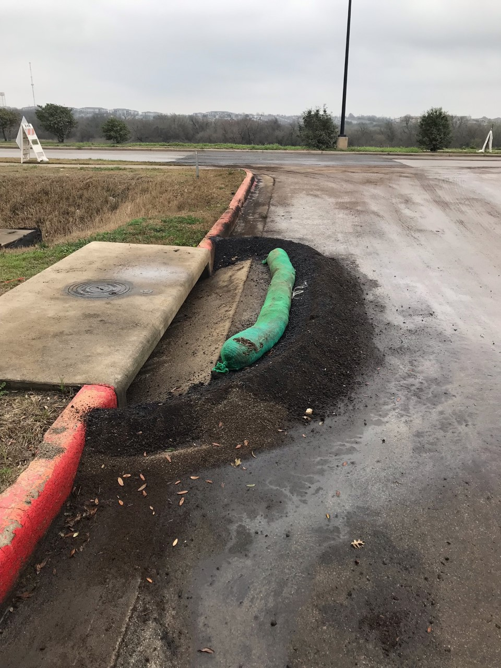

Slide 34
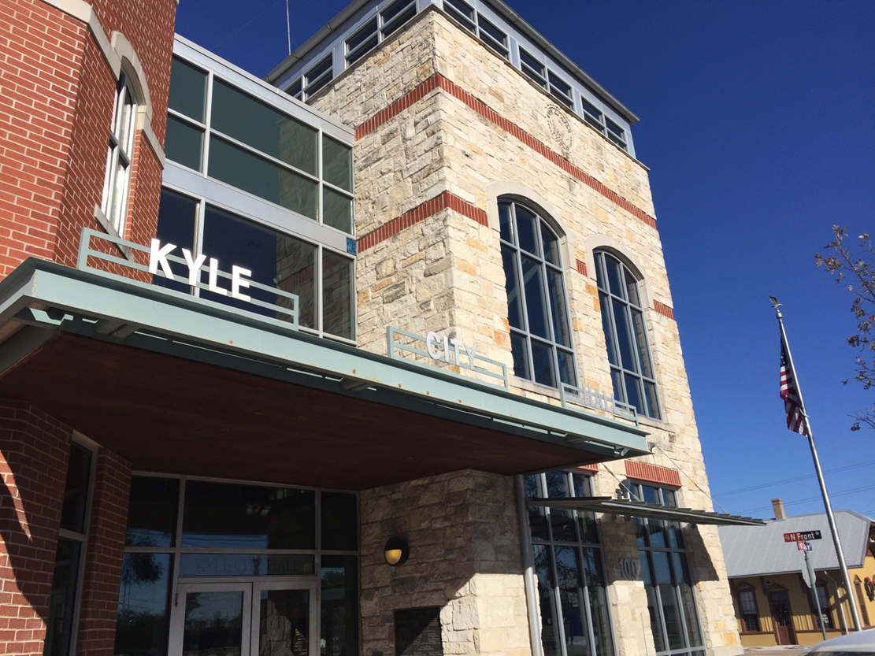
Questions
Kathy Roecker
Stormwater Management Plan Administrator
(512) 618-8296
kroecker@cityofkyle.com
Stormwater

Slide 35
“What about my watershed?”
Around the room are posters with questions on them. Take a few minutes to go answer some of the questions. After time is up well will discuss answers. Here are the questions posted:
“Do you use water from Plum Creek or it’s tributaries? If so how?”
“What are your top watershed concerns? What water or land issues concern or impact you the most?”
“What watershed issues should be focused on in your opinion?”
“What is your opinion on the water quality in Plum Creek or the region?”

Slide 36
Upcoming events
Last Feral Hog Bounty Claim event: July 20th
Feral Hog Management Roundtable
July 25th, 1PM to 3PM at the Scott Annex in Lockhart, TX
Texas Watershed Stewardship Workshop
August 15th, 1PM to 5PM at Cabela’s in the Palo Duro-White Tail Room in Buda, TX

Slide 37
Next Meeting
Next Public Stakeholder meeting will be in January of 2024

Slide 38
THANK YOU!
Sean Melvin
smelvin@plumcreekwatershed.org
830-557-7358
plumcreekwatershed.org
Funding for the development and support of the Plum Creek Watershed Protection Plan is through a Clean Water Act grant provided by the Texas State Soil and Water Conservation Board and U.S. Environmental Protection Agency.

