Slide 1
Welcome to the Plum Creek Public Stakeholder Meeting!
Please sign in and help yourself to the refreshments

Slide 2
Plum Creek Watershed Partnership
Public Stakeholder Meeting
Kyle Public Library
February 28th, 2024

Slide 3
Meeting Overview
Today’s agenda:
Updates on the Plum Creek watershed
A special presentation on advocacy from Hill Country Alliance
A period of open discussion
Upcoming Events
Plum Creek Steering Committee mingle

Slide 4
The 2024 Watershed Protection Plan Update
Every two years the Partnership completes an update to the Plum Creek Watershed Protection Plan (WPP). It is currently in the draft phrase and will be released later this year. The update looks at…
Reviewing Milestones and Measures of Success
Analyzing water quality trends
Highlighting what has been done in the watershed through the reporting period
A review on the state of the Plum Creek Watershed
Notes:
Last update looked at data from 2008 to Q3 of 2021

Slide 5
The Plum Creek Watershed Partnership
The Partnership is composed of 12 partners which include:
Hays County
Caldwell County
Guadalupe-Blanco River Authority
City of Kyle
City of Buda
City of Lockhart
City of Uhland
City of Luling
Hays County Soil & Water Conservation District
Caldwell-Travis Soil & Water Conservation District
Plum Creek Conservation District
Aqua Water Supply Corp.

Slide 6
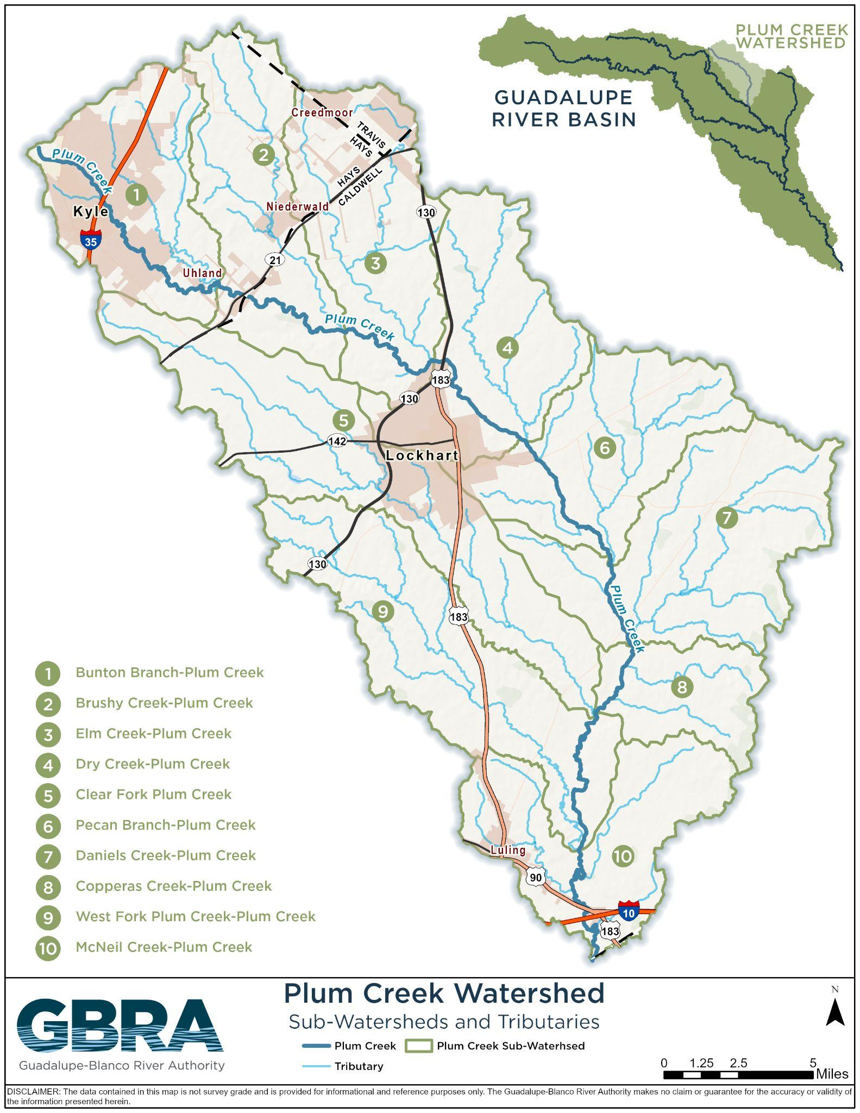
Plum Creek Watershed
The watershed
Stretches across Hays and Caldwell County and the cities of Kyle, Buda, Uhland, Lockhart and Luling
~400 square miles with Plum Creek measuring 52 miles
Is a significant tributary to the San Marcos River
The issues in the watershed
Impaired for E. coli bacteria (since 2004)
Concerns for Nitrate Nitrogen, Ammonia Nitrogen, Total Phosphorus, impaired macrobenthic community, dissolved oxygen, impaired fish community and impaired habitat

Slide 7
2022 Texas Integrated Report - Basin 18
Assessment Unit | Parameter | Status
1810_1 (near confluence with San Marcos River) | E. coli (Geomean) Nitrate (nutrient) Total Phosphorus Fish Community Aquatic Habitat | Nonsupport (4b) Concern for screening level Concern for screening level Nonsupport Concern for screening level
1810_2 (~2.5 miles upstream of confluence with Clear Fork) | E. coli (Geomean) Nitrate (nutrient) Total Phosphorus Fish Community Aquatic Habitat | Nonsupport (4b) Concern for screening level Concern for screening level Use Concern Concern for screening level
1810_3 (~0.5 miles upstream of State Hwy 21) | E. coli (Geomean) Nitrate (nutrient) Total Phosphorus Ammonia Macrobenthic community Fish Kill Report | Nonsupport (4b) Concern for screening level Concern for screening level Concern for screening level Use Concern Use Concern
1810A_01 Town Branch (perennial stream in Lockhart) | E. coli (Geomean) Nitrate (nutrient) Dissolved O2 (grab) | Nonsupport (4b) Concern for screening level Concern for screening level
Since the implementation of the WPP, Plum Creek (segment 1810) continues to be recognized by the State of Texas as impaired for Primary Contact Recreation.
Here listed are the current impairments and concerns in Plum Creek as described in the 2022 Texas Integrated Report by TCEQ.
Highest average concentration of E. coli is at the 1810_3 segment
You can view the impaired stream information on TCEQ’s Surface Water Quality Segment Viewer. Link:
https://www.tceq.texas.gov/gis/segments-viewer
Notes:
Explained impaired…

Slide 8
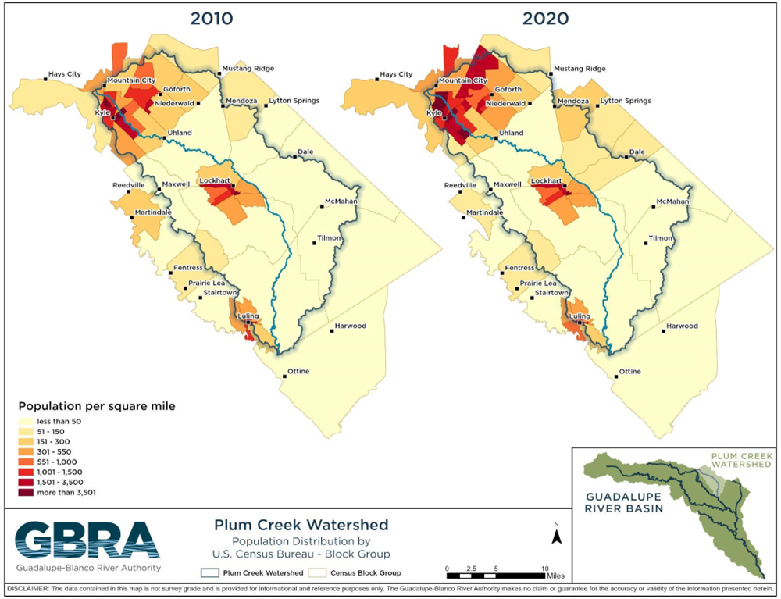

Slide 9
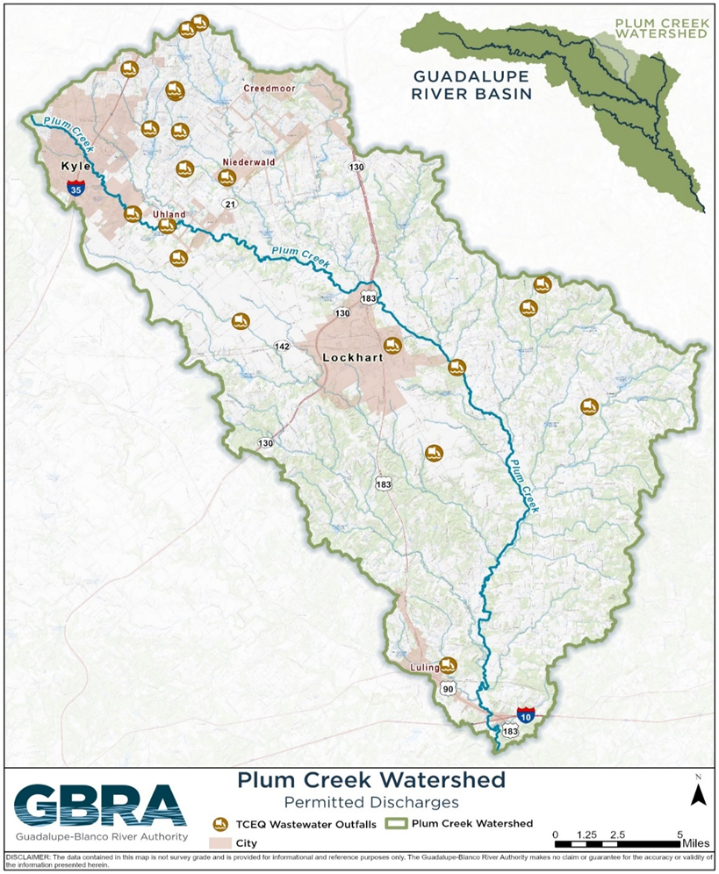
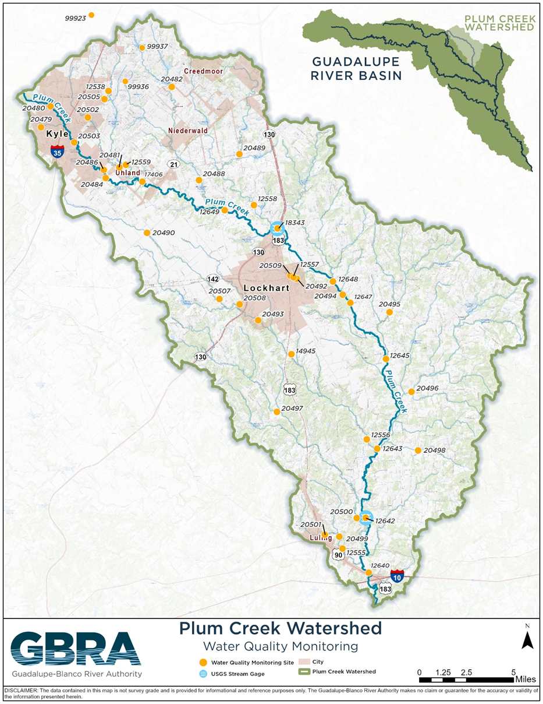

Slide 10
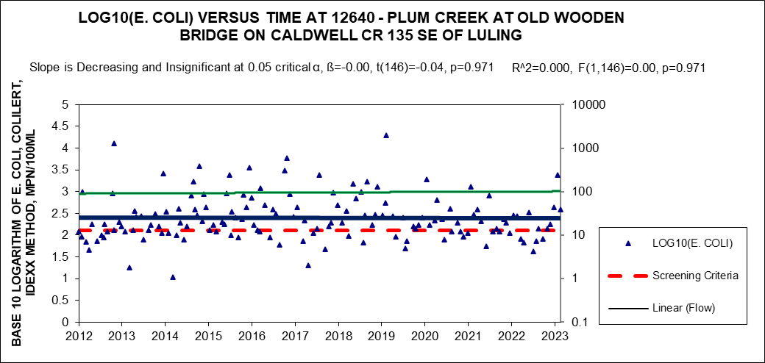
The Plum Creek Watershed Trends
The following figures show the E. coli water quality trends for the three main monitoring sites along Plum Creek. Site 12640 is in the lower segment of Plum Creek (the most downstream site).

Slide 11
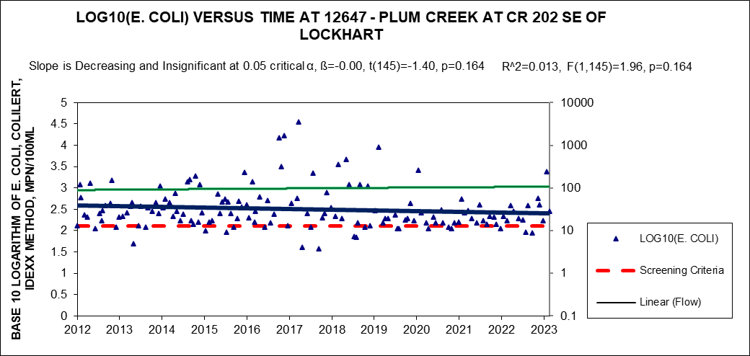
The Plum Creek Watershed Trends
The following figures show the E. coli water quality trends for the three main monitoring sites along Plum Creek. Site 12647 is located in the middle segment of Plum Creek.

Slide 12
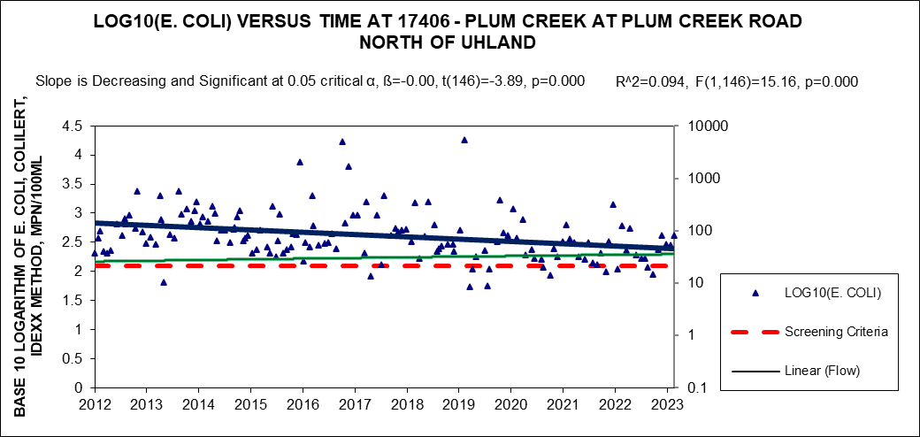
The Plum Creek Watershed Trends
The following figures show the E. coli water quality trends for the three main monitoring sites along Plum Creek. Site 17406 is located in the upper segment of Plum Creek (the most upstream site).

Slide 13
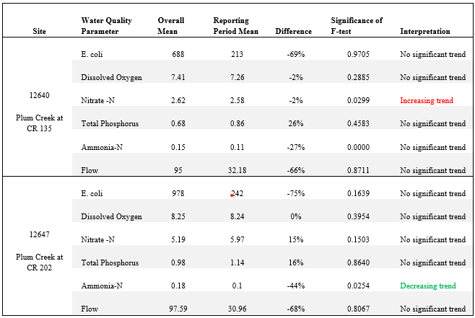
The Plum Creek Watershed Trends
This table shows all three main stem sites for Plum Creek and the trends the water quality parameter recorded.

Slide 14
Plum Creek Milestones and Measures of Success
In the original WPP (2008), milestones and measures of success were outlined to be accomplished through implementation. Highlights from this reporting period include:
Five new pet waste stations installed
One wastewater treatment upgrade for phosphorus removal
1,413 feral hogs harvested
One new Water Quality Management Plan Technician
In addition, efforts that have continued through this reporting period include:
City of Kyle, Buda and Lockhart street sweeping program
Feral hog education
Water quality monitoring with GBRA
Education and outreach activities

Slide 15
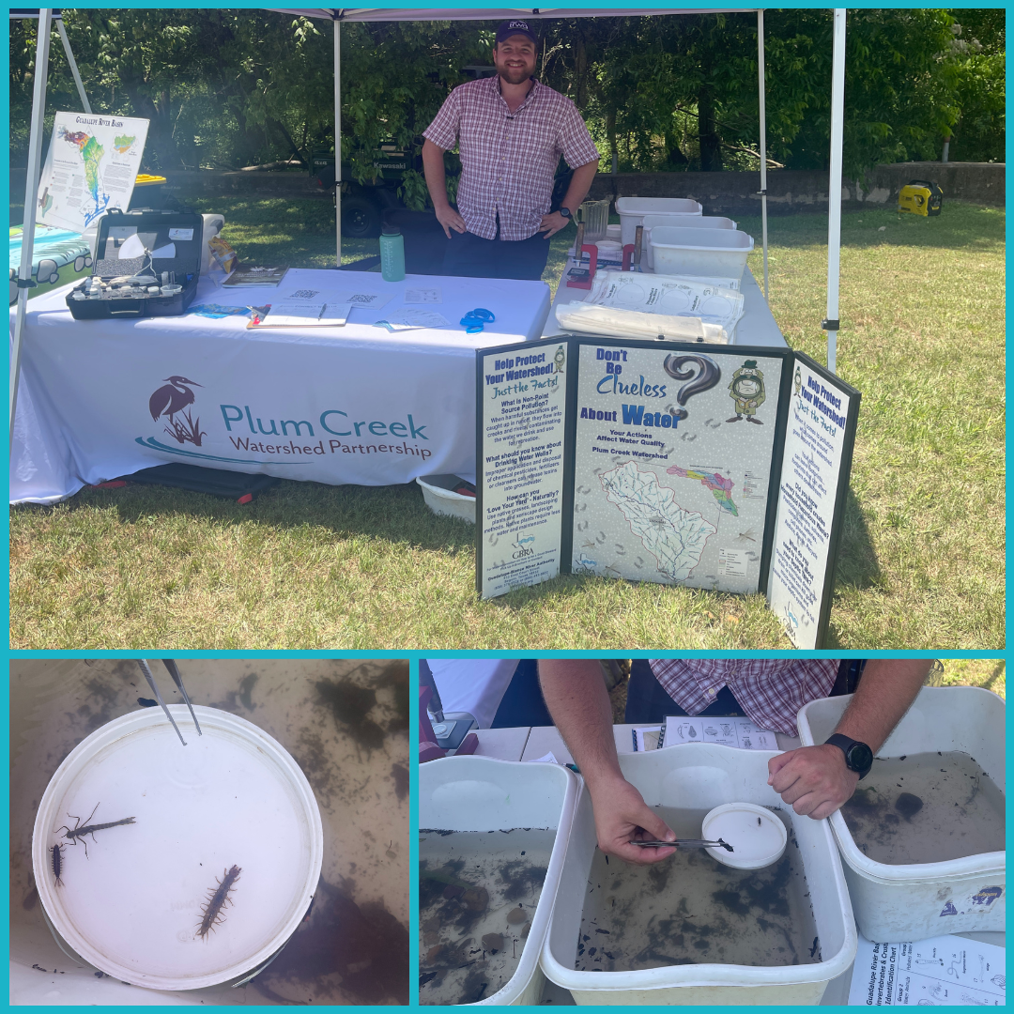
Plum Creek Outreach Activities
In this past reporting period, the Partnership helped facilitate educational outreach and has reached over 3,000 individuals. This was through:
Elementary school Water Quality Project
Educational workshops
Displays and presentations at events
Community cleanups

Slide 16
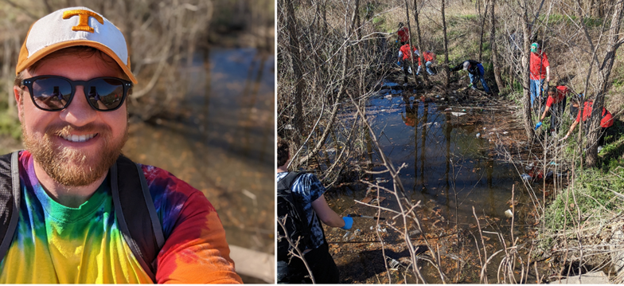
Plum Creek Outreach Activities
In this reporting period there have been
Three community litter cleanups
Total of 204 volunteers, collecting over 5000 lbs of trash and 260 lbs of recyclables
Five Caldwell County tire-only community cleanups
Total of 46 volunteers collecting 110 tons of tires and refuse
Two City of Lockhart household hazardous waste drop off events
125 and then 137 households participated in disposing hhw
Two City of Kyle community cleanup
First event, filled ten 40-yard roll offs of landfill waste and one 40-yard roll off of recyclable metal
Second event for only tires and electronics, 35 tires and 1,422 lbs of electronics were collected for recycling

Slide 17
Questions?

Slide 18
HCA Presentation
(Placeholder)

Slide 19
Open Discussion Time
The floor is open for discussion. Let us take a brief moment to discuss our watershed thoughts and concerns. Topics can include:
Your water quality concerns
Educational opportunities / workshop you would like have
Watershed focused community events
Water quality projects you would like to be considered

Slide 20
Upcoming events
39th Annual Great Texas River Cleanup
Saturday, March 2nd at 8:30 AM
Healthy Lawns Health Waters Workshop
Friday, April 5th
Lone Star Healthy Streams Workshop
Thursday, April 18 at Lockhart State Park

Slide 21
THANK YOU
and let’s mingle!
Sean Melvin
smelvin@plumcreekwatershed.org
830-557-7358
plumcreekwatershed.org
Funding for the development and support of the Plum Creek Watershed Protection Plan is through a Clean Water Act grant provided by the Texas State Soil and Water Conservation Board and U.S. Environmental Protection Agency.

